Slide 1
Typescript for productivity
Why you should use it in every project with multiple developers

Slide 2
Introduction
The purpose of the talk is to convince those who are not using TypeScript to give it a try in their next project.
I hope to convince you why I think TypeScript is indispensable for projects with a team of developers.

Slide 3
Introduction to TypeScript
TypeScript is a superset of JavaScript that adds (optional) type annotations and, thus, static typing on top of JavaScript.
TypeScript is open-source and supported by Microsoft.
Microsoft introduces TypeScript as “JavaScript that scales”.
Most of the JS code we write on the front-end is transpiled anyways, so why not add static type checking to the step?

Slide 4
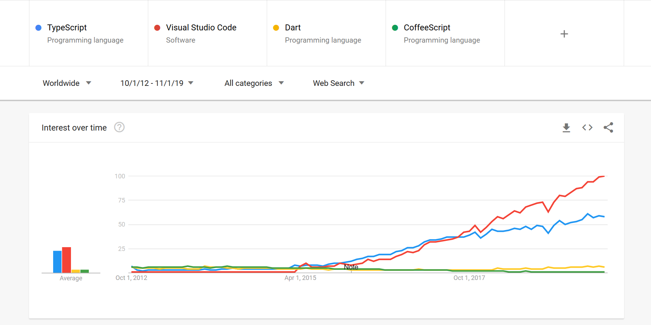
Notes:
TS first appeared on October 1, 2012
Visual Studio Code was released on April 29, 2015
Angular 2 (which adopted TS) was released in September 2016

Slide 5
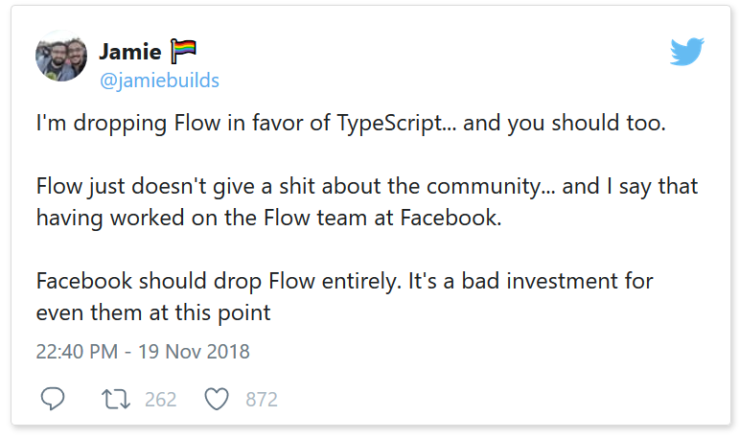
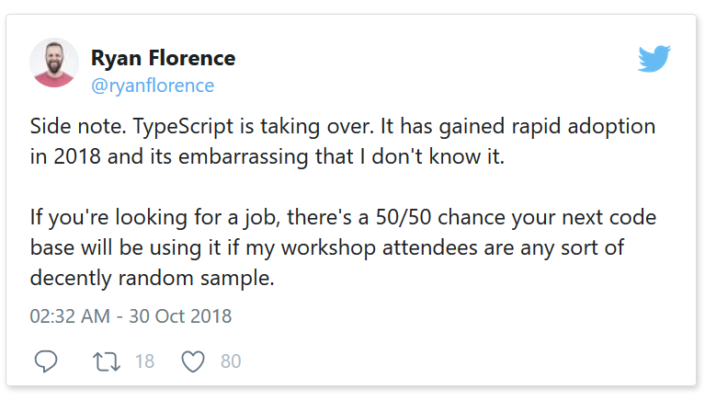
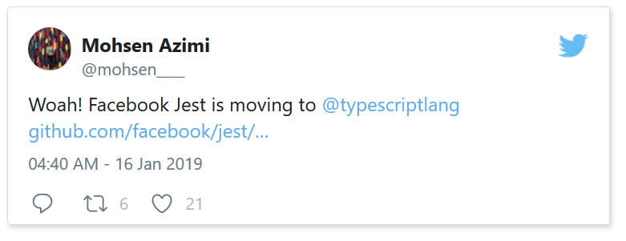
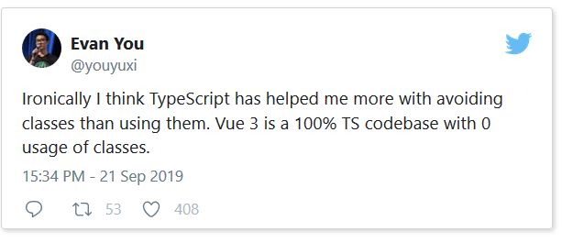
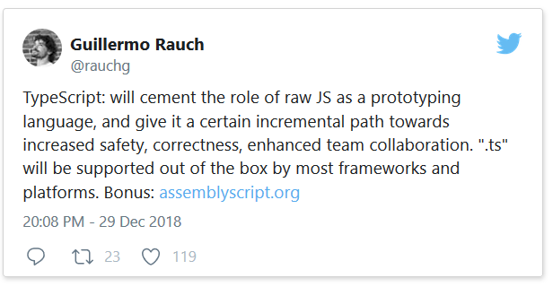
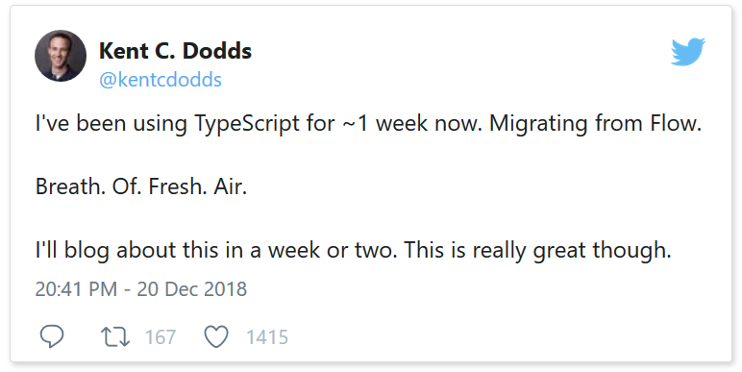
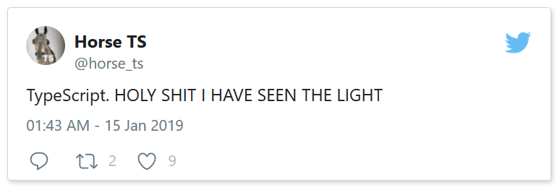

Slide 6
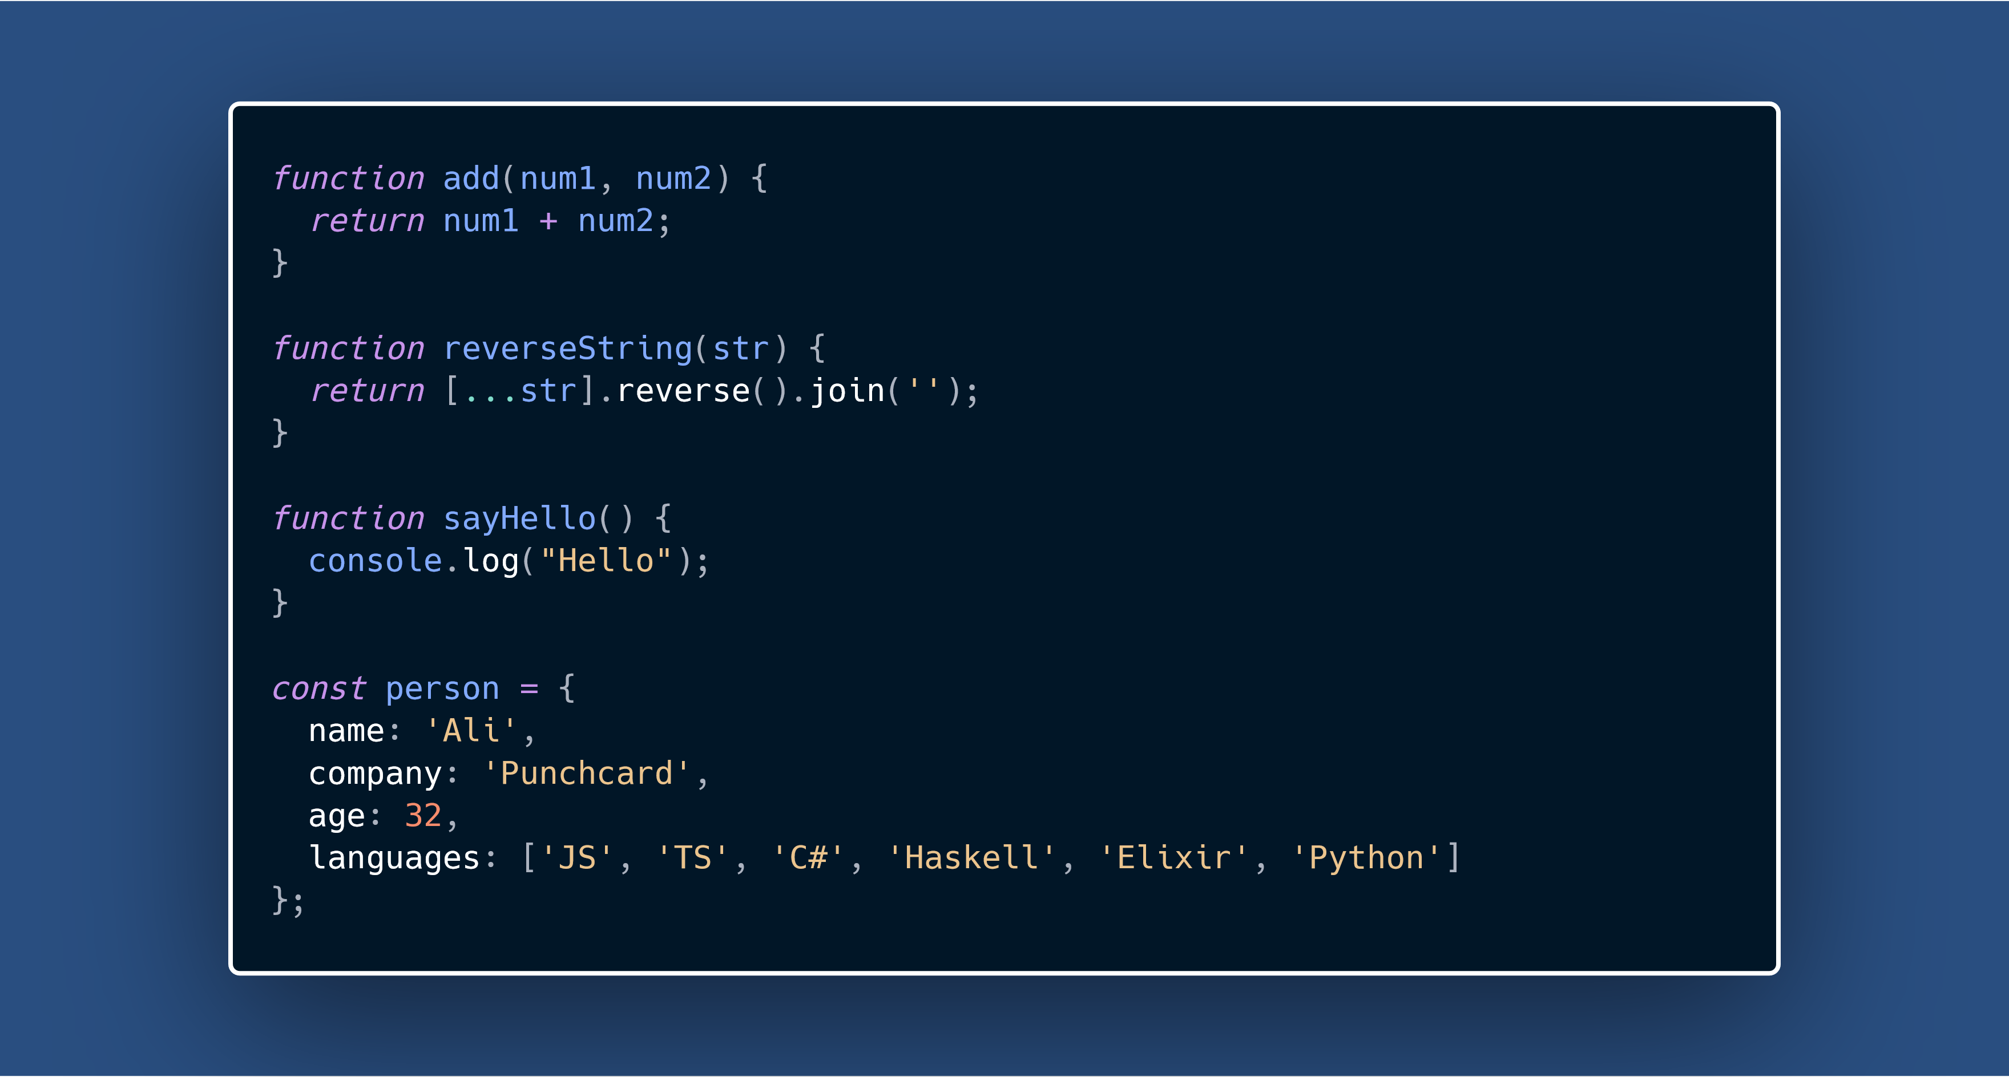

Slide 7
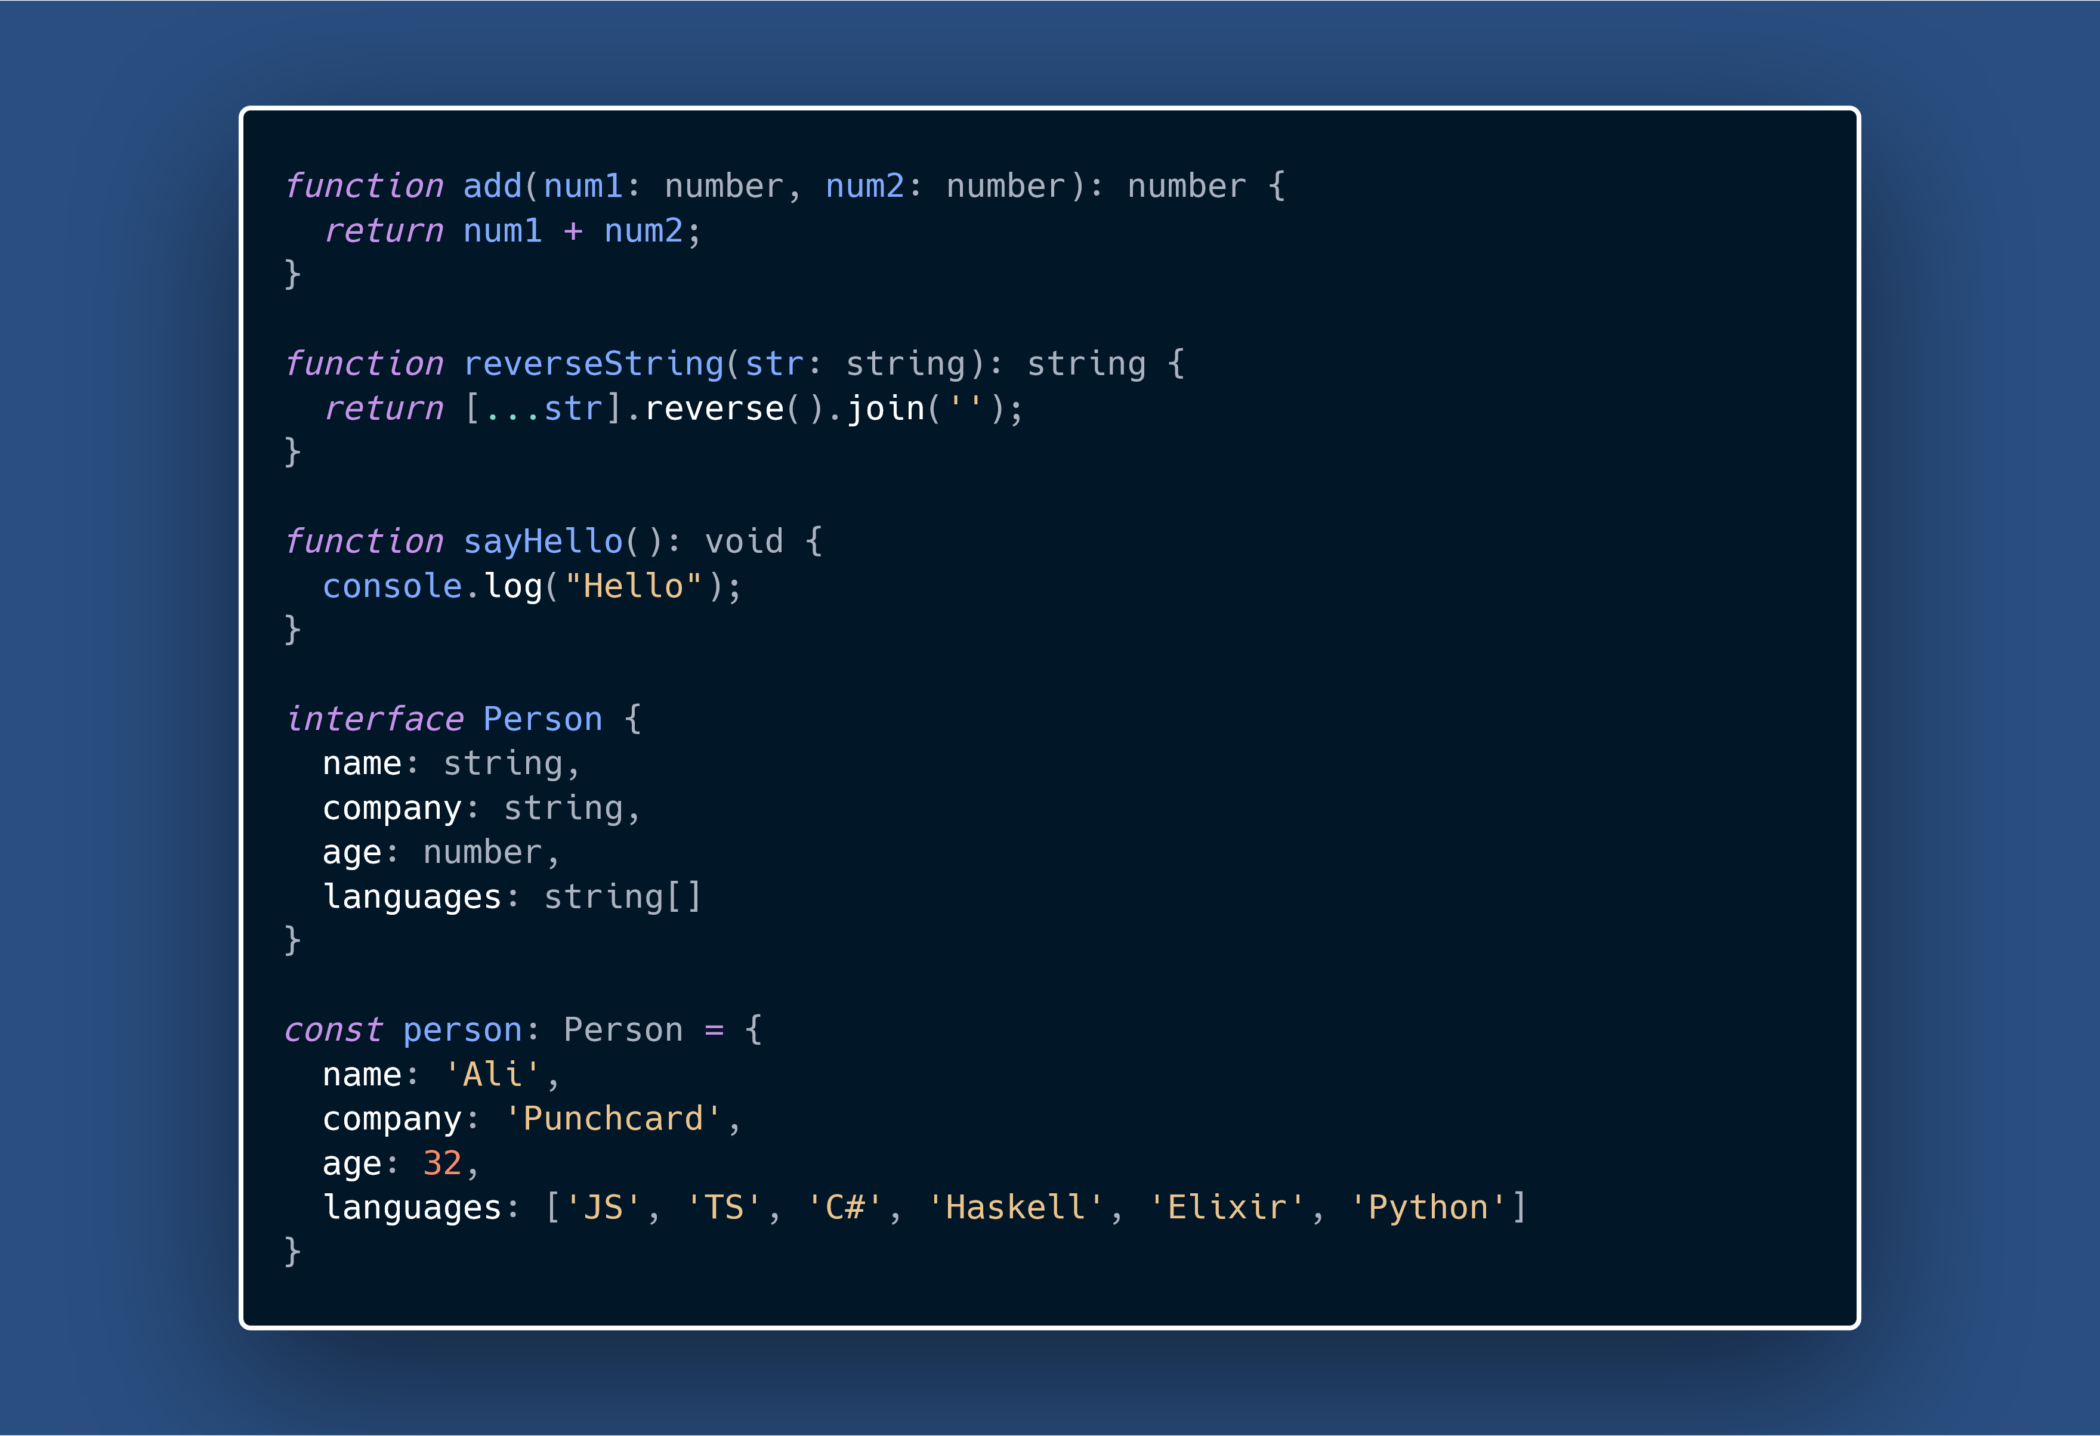

Slide 9
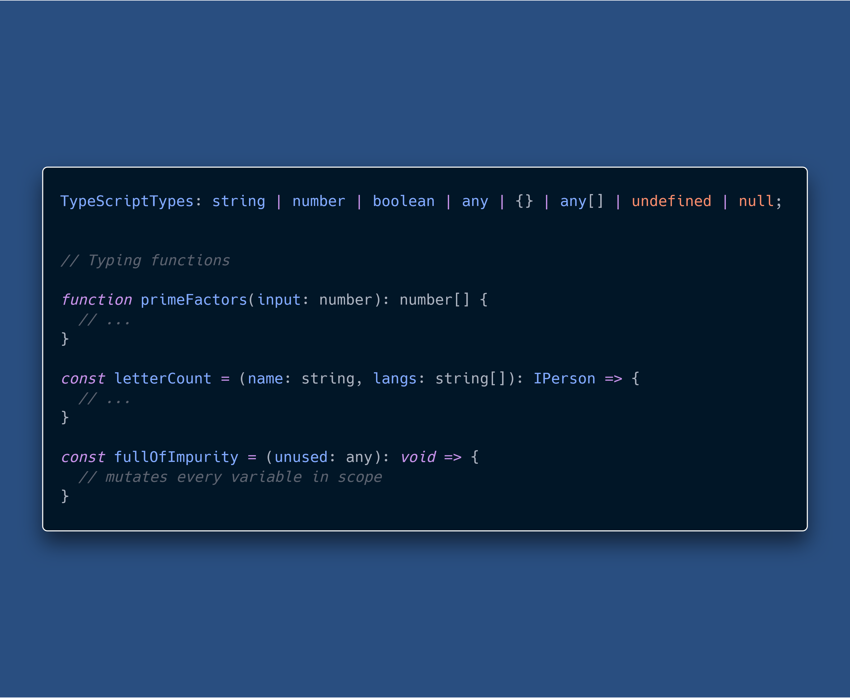
TS Basics

Slide 10
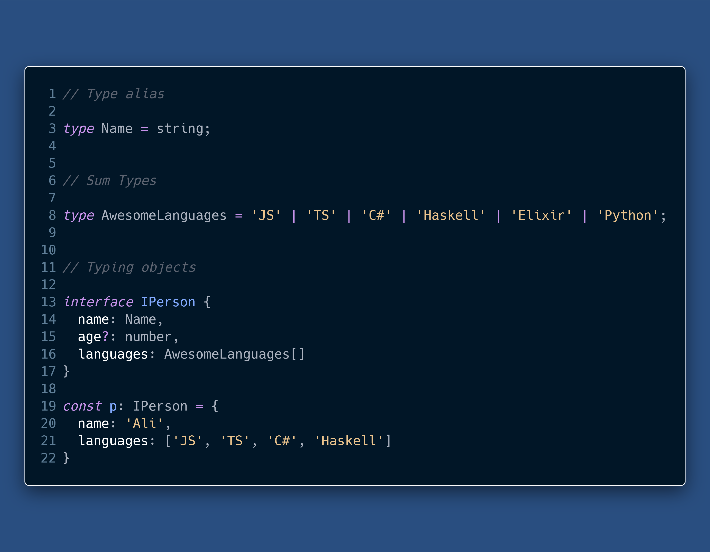
TS Basics

Slide 11
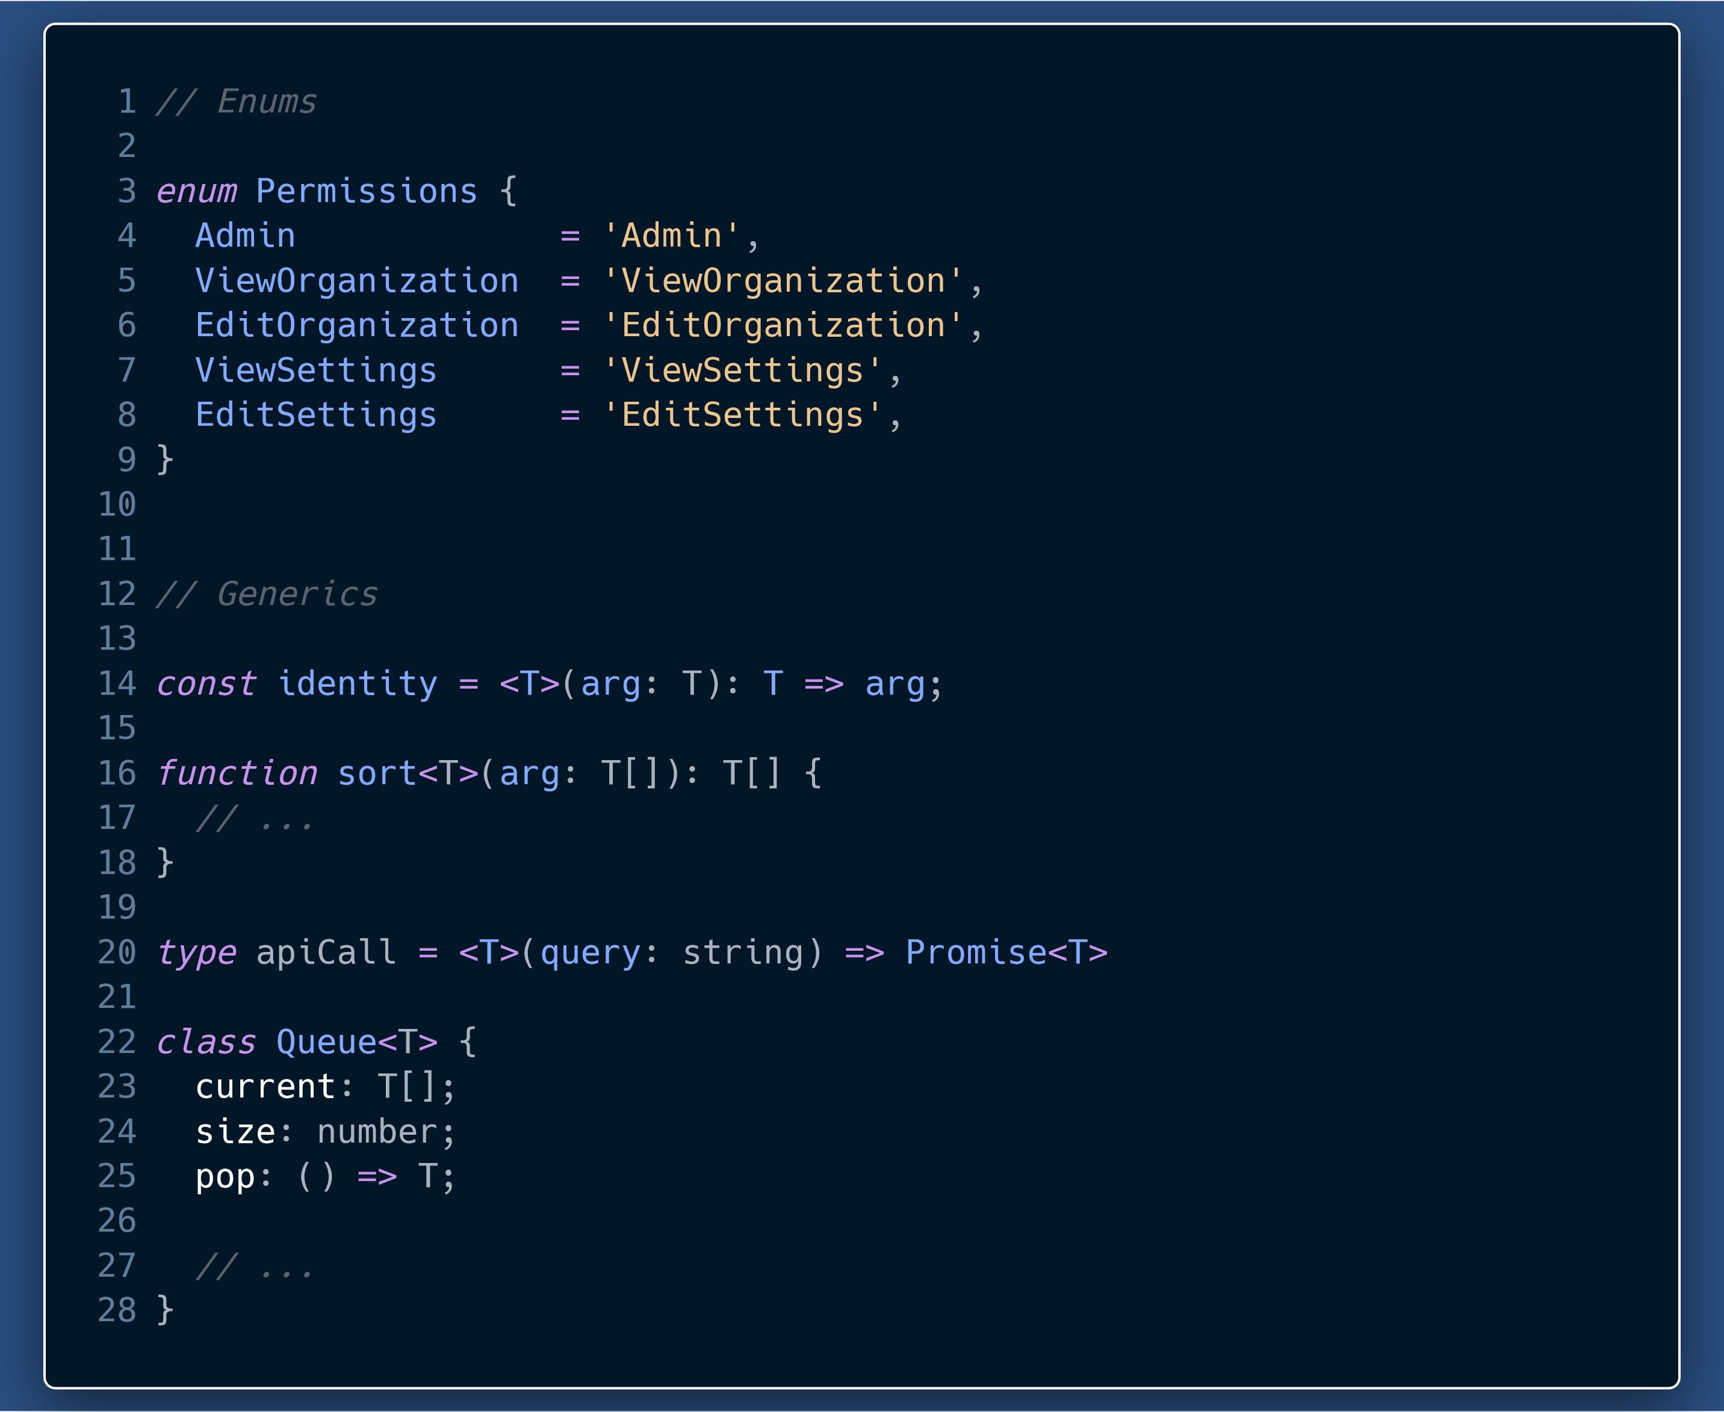
TS Basics

Slide 12
Why TypeScript ?

Slide 13
Why TS?
Readable, easily understandable and scalable code.
Self documenting code
Ease of communication among developers
Maintenance & Refactoring
Thinking about types in your program makes you a better developer
Static analysis and fewer run-time errors
Editor Superpowers
Union Types

Slide 14
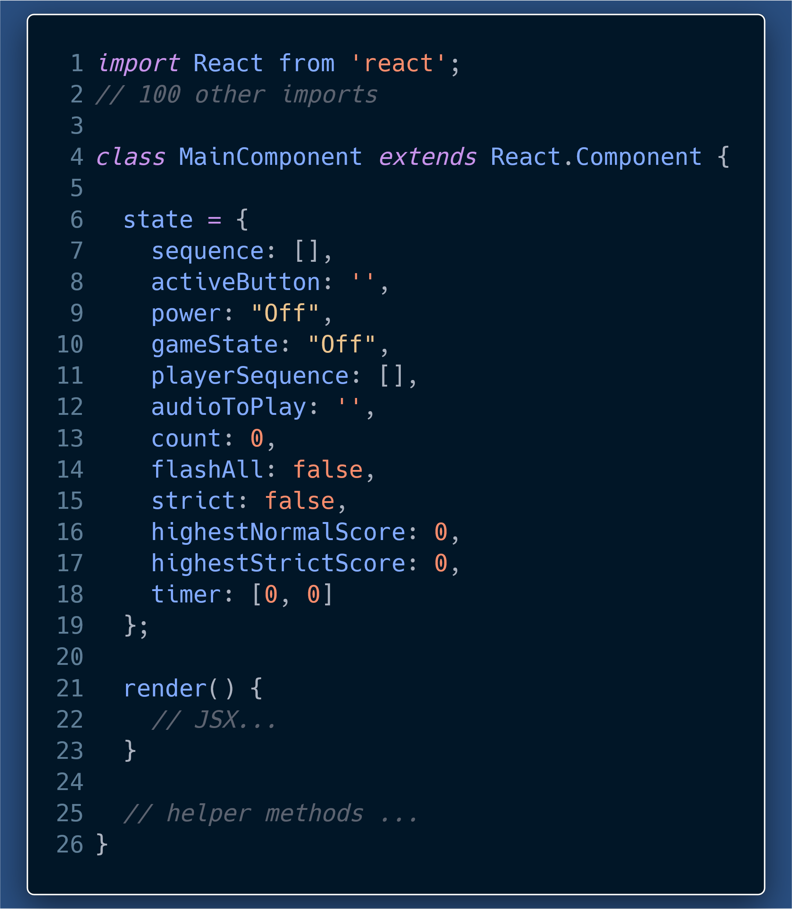
How many and what type of props does this component take?
What is each state item supposed to be?
With JSX and helper methods included, this component will be a lot harder to decipher for a first time or a long-lost reader (me after one month).

Slide 15
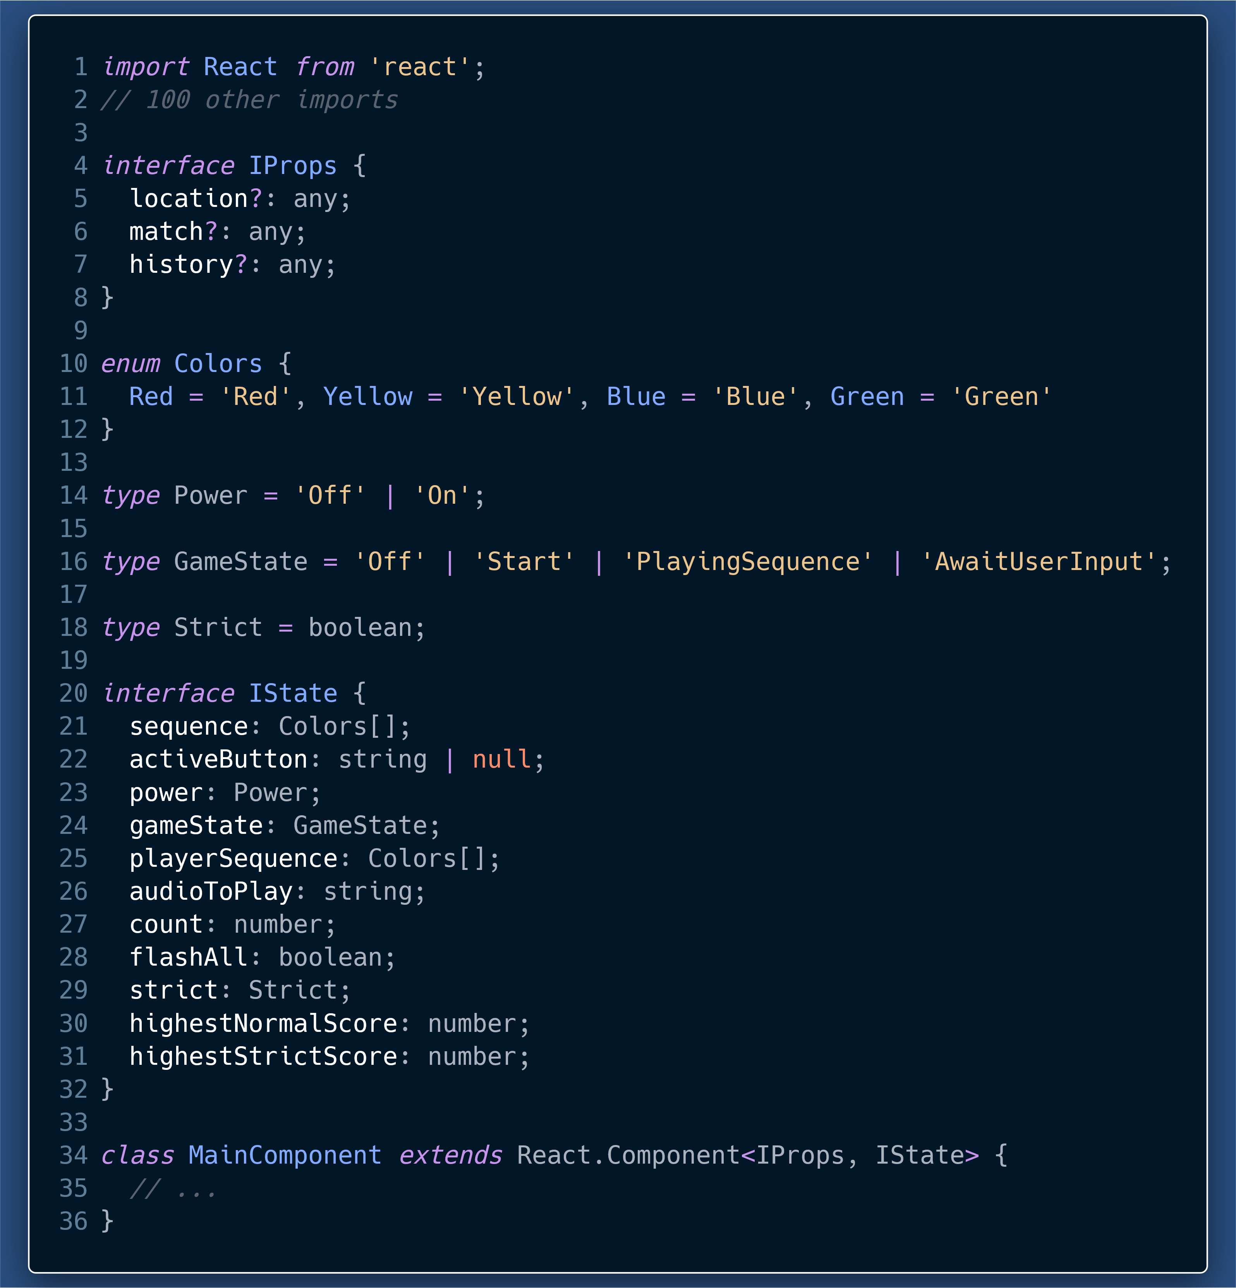
We can now clearly see the:
Exact props and types of props.
Number and types of each state property.
The best part is that the Code itself is acting as documentation.
Types add a layer of documentation on top of JS code.

Slide 16
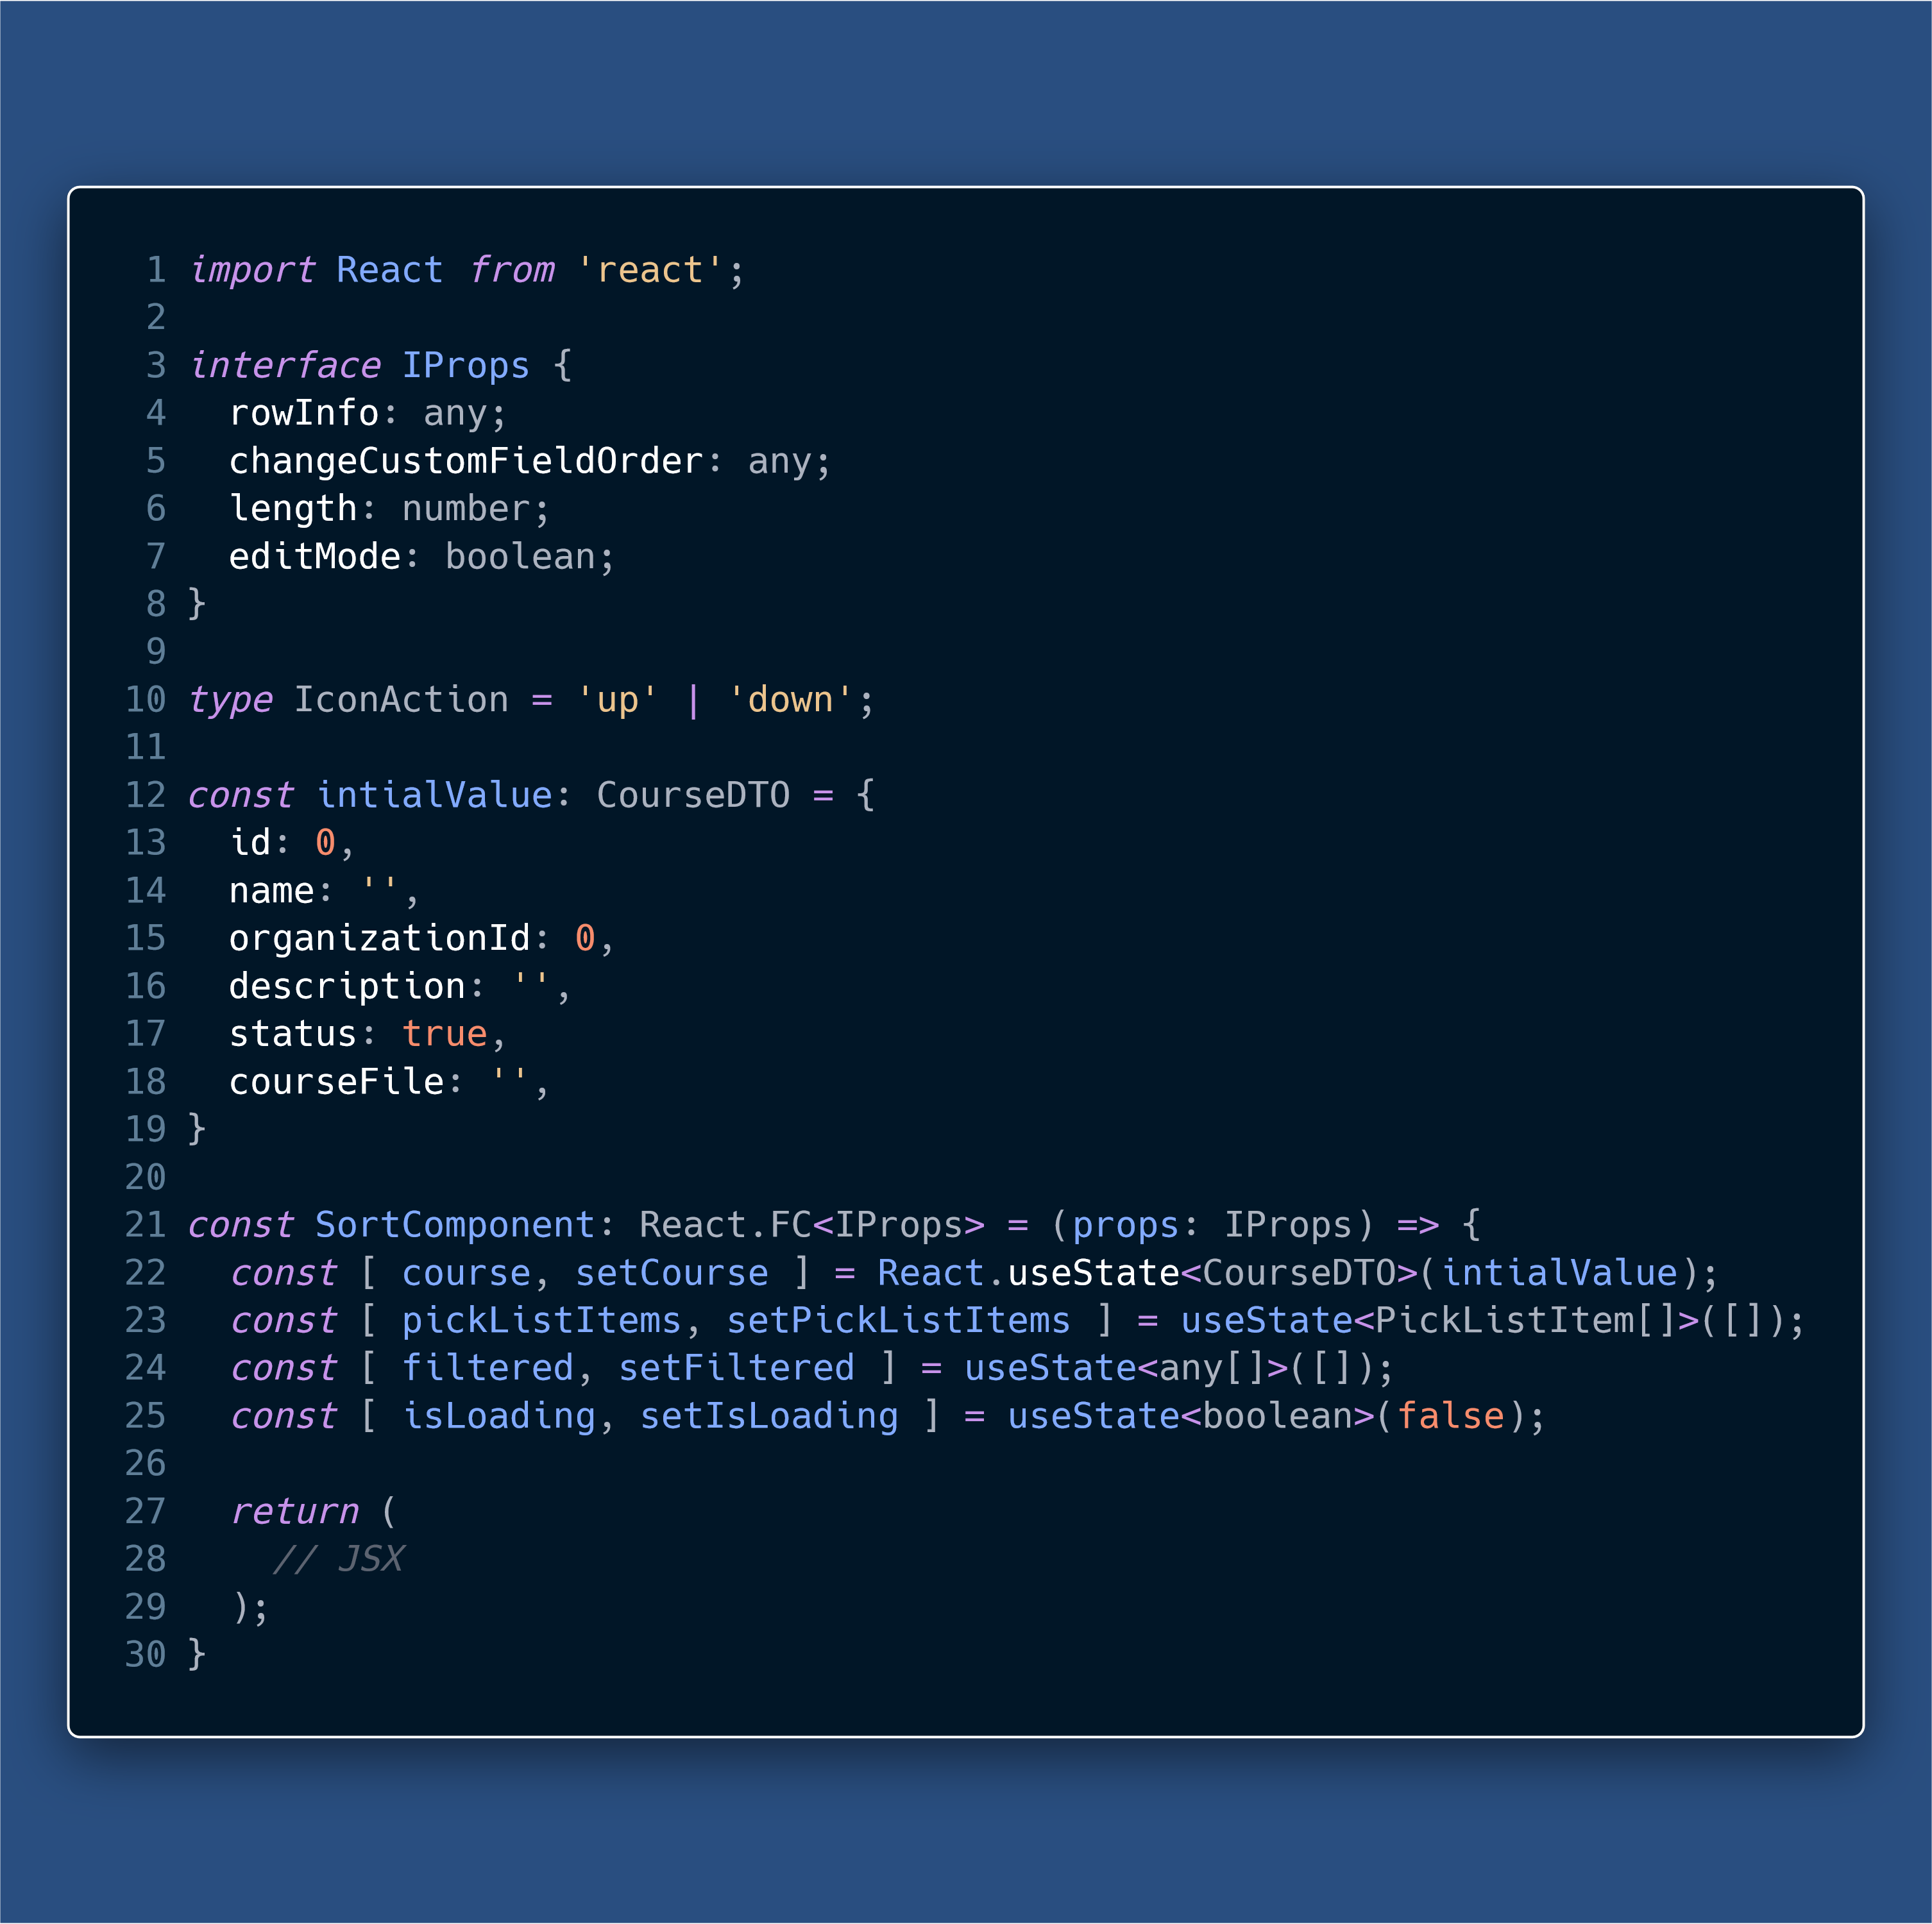

Slide 17
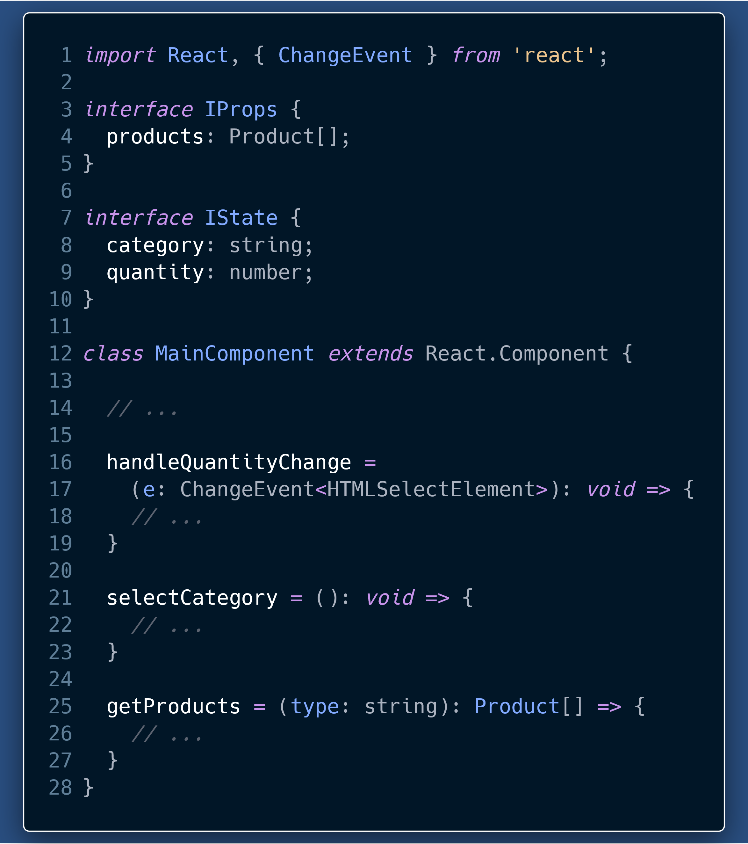
Typing your functions and helpers
promotes “Design by Contract”
Helps identify things like
pure functions from those with side-effects.
The arguments a function takes, what is its return type.
Helps during refactoring where a developer instantly knows the purpose of a function, just from reading types.

Slide 18
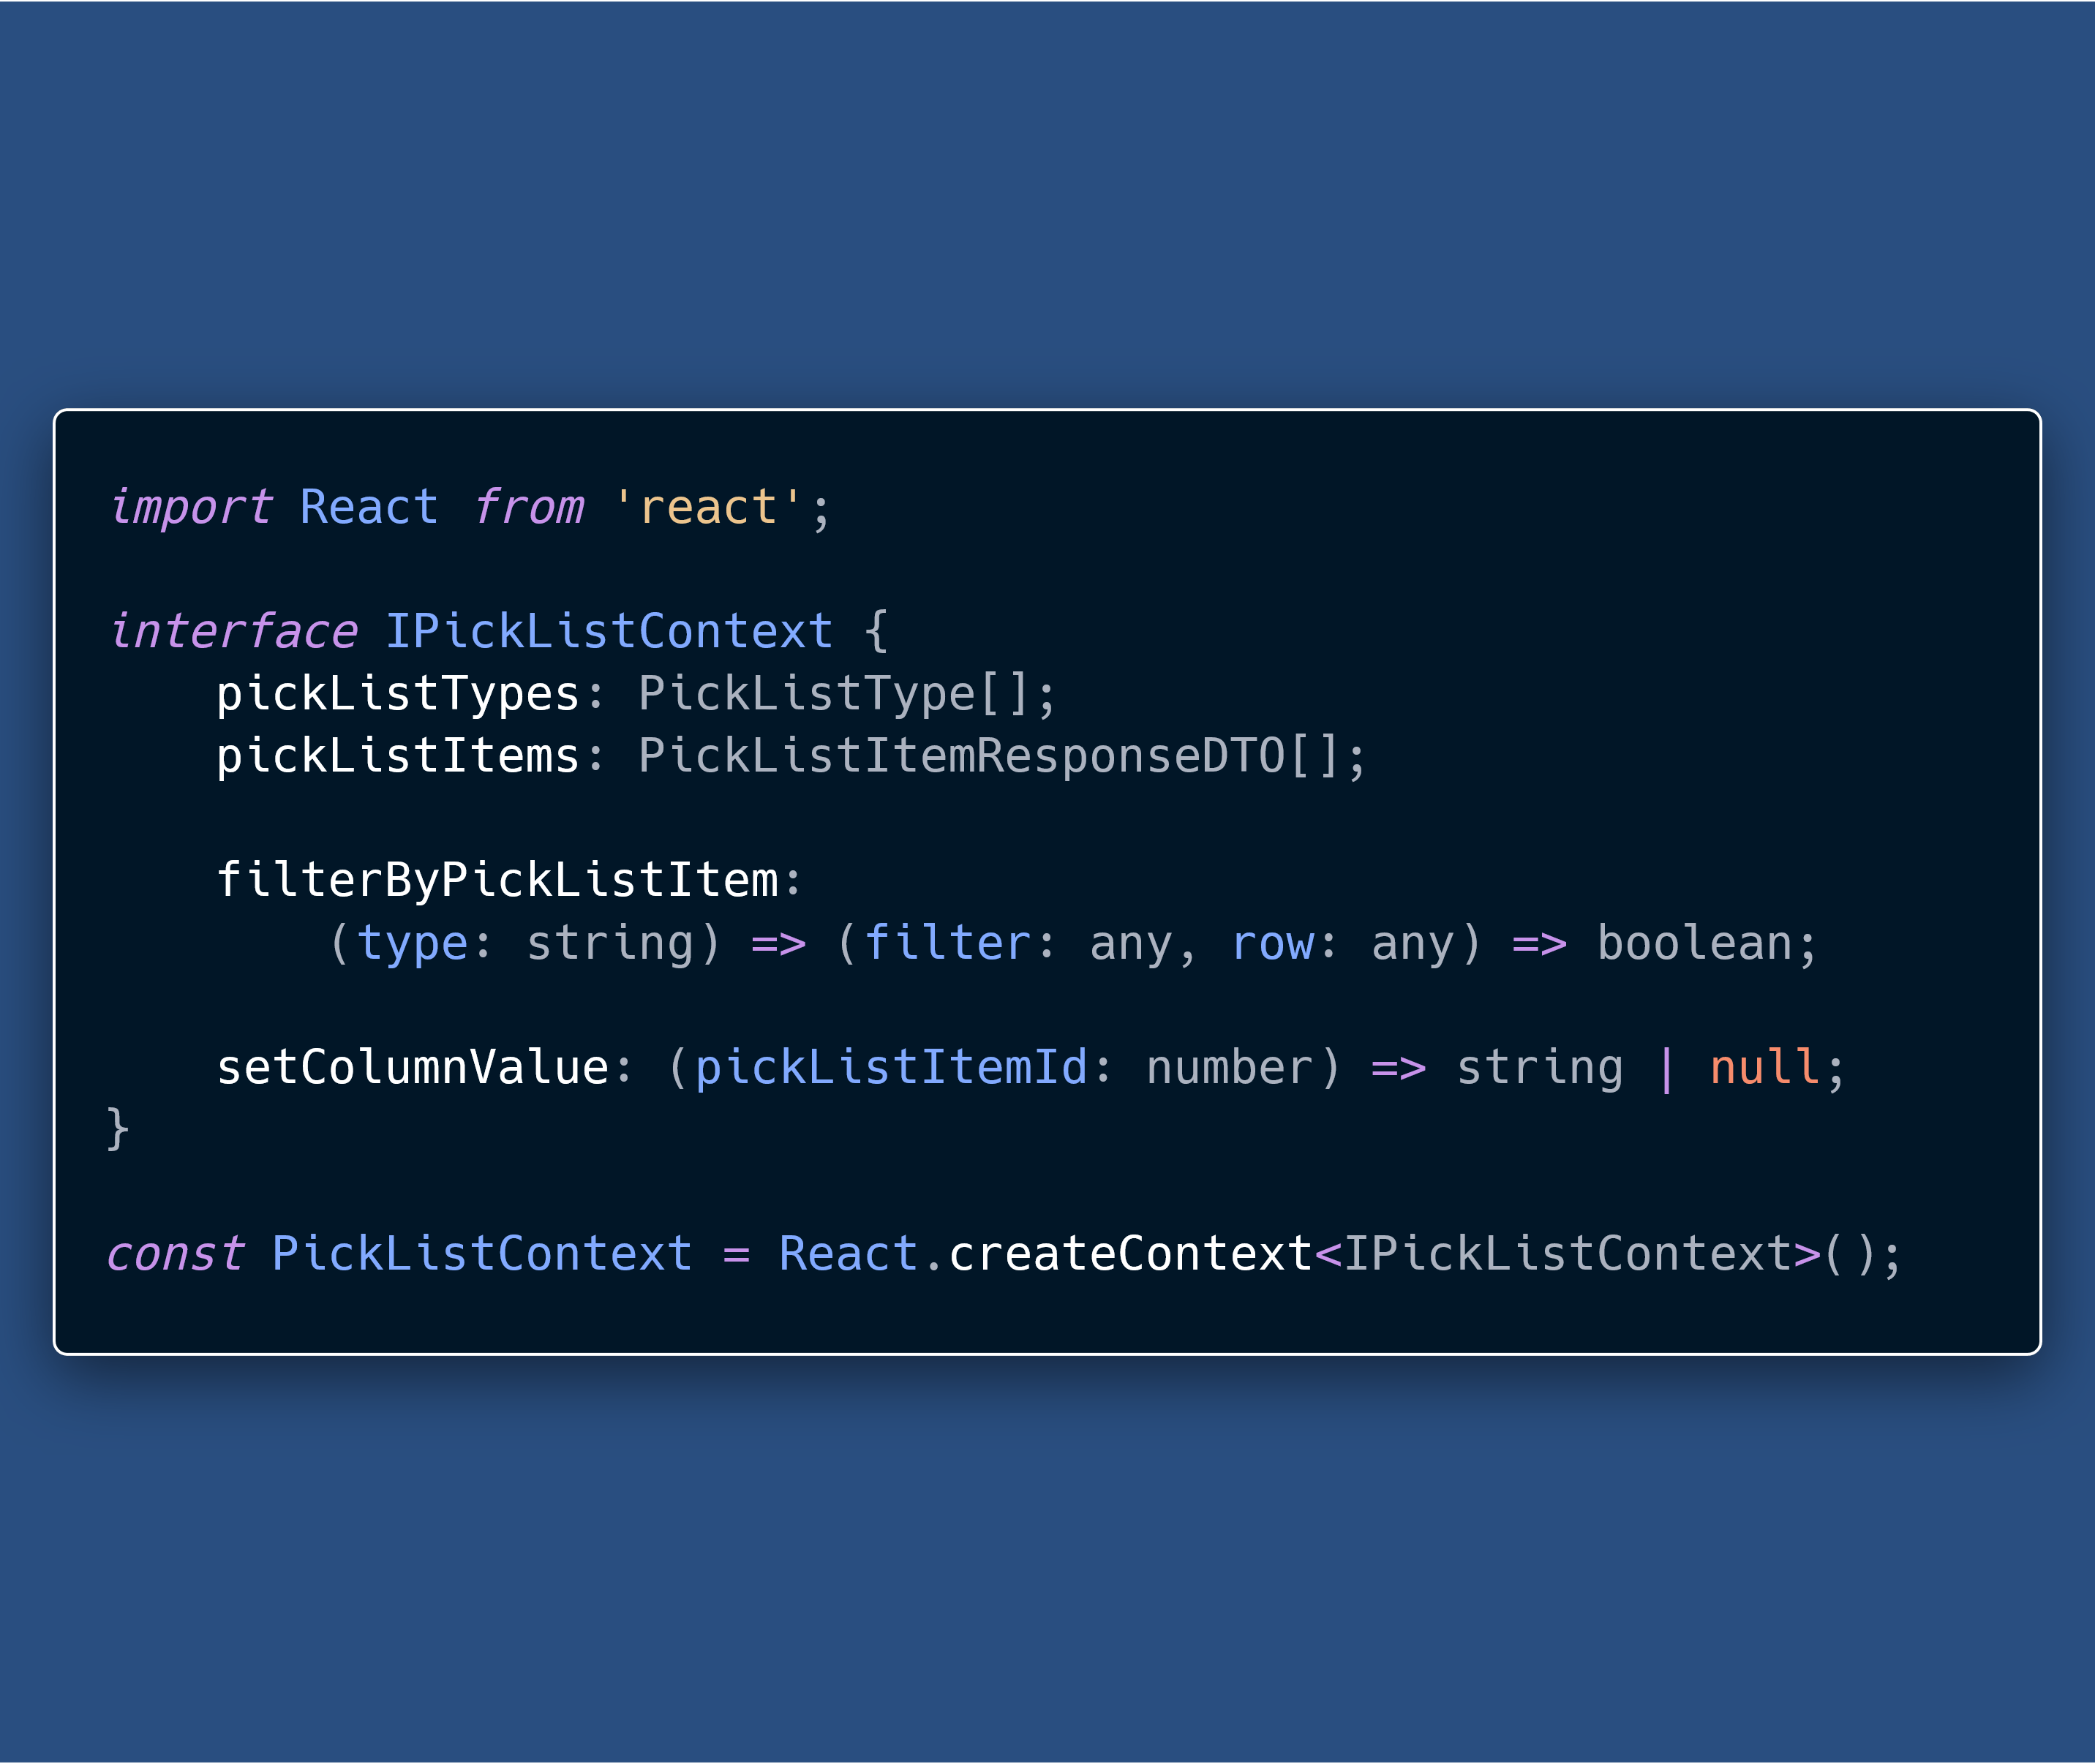
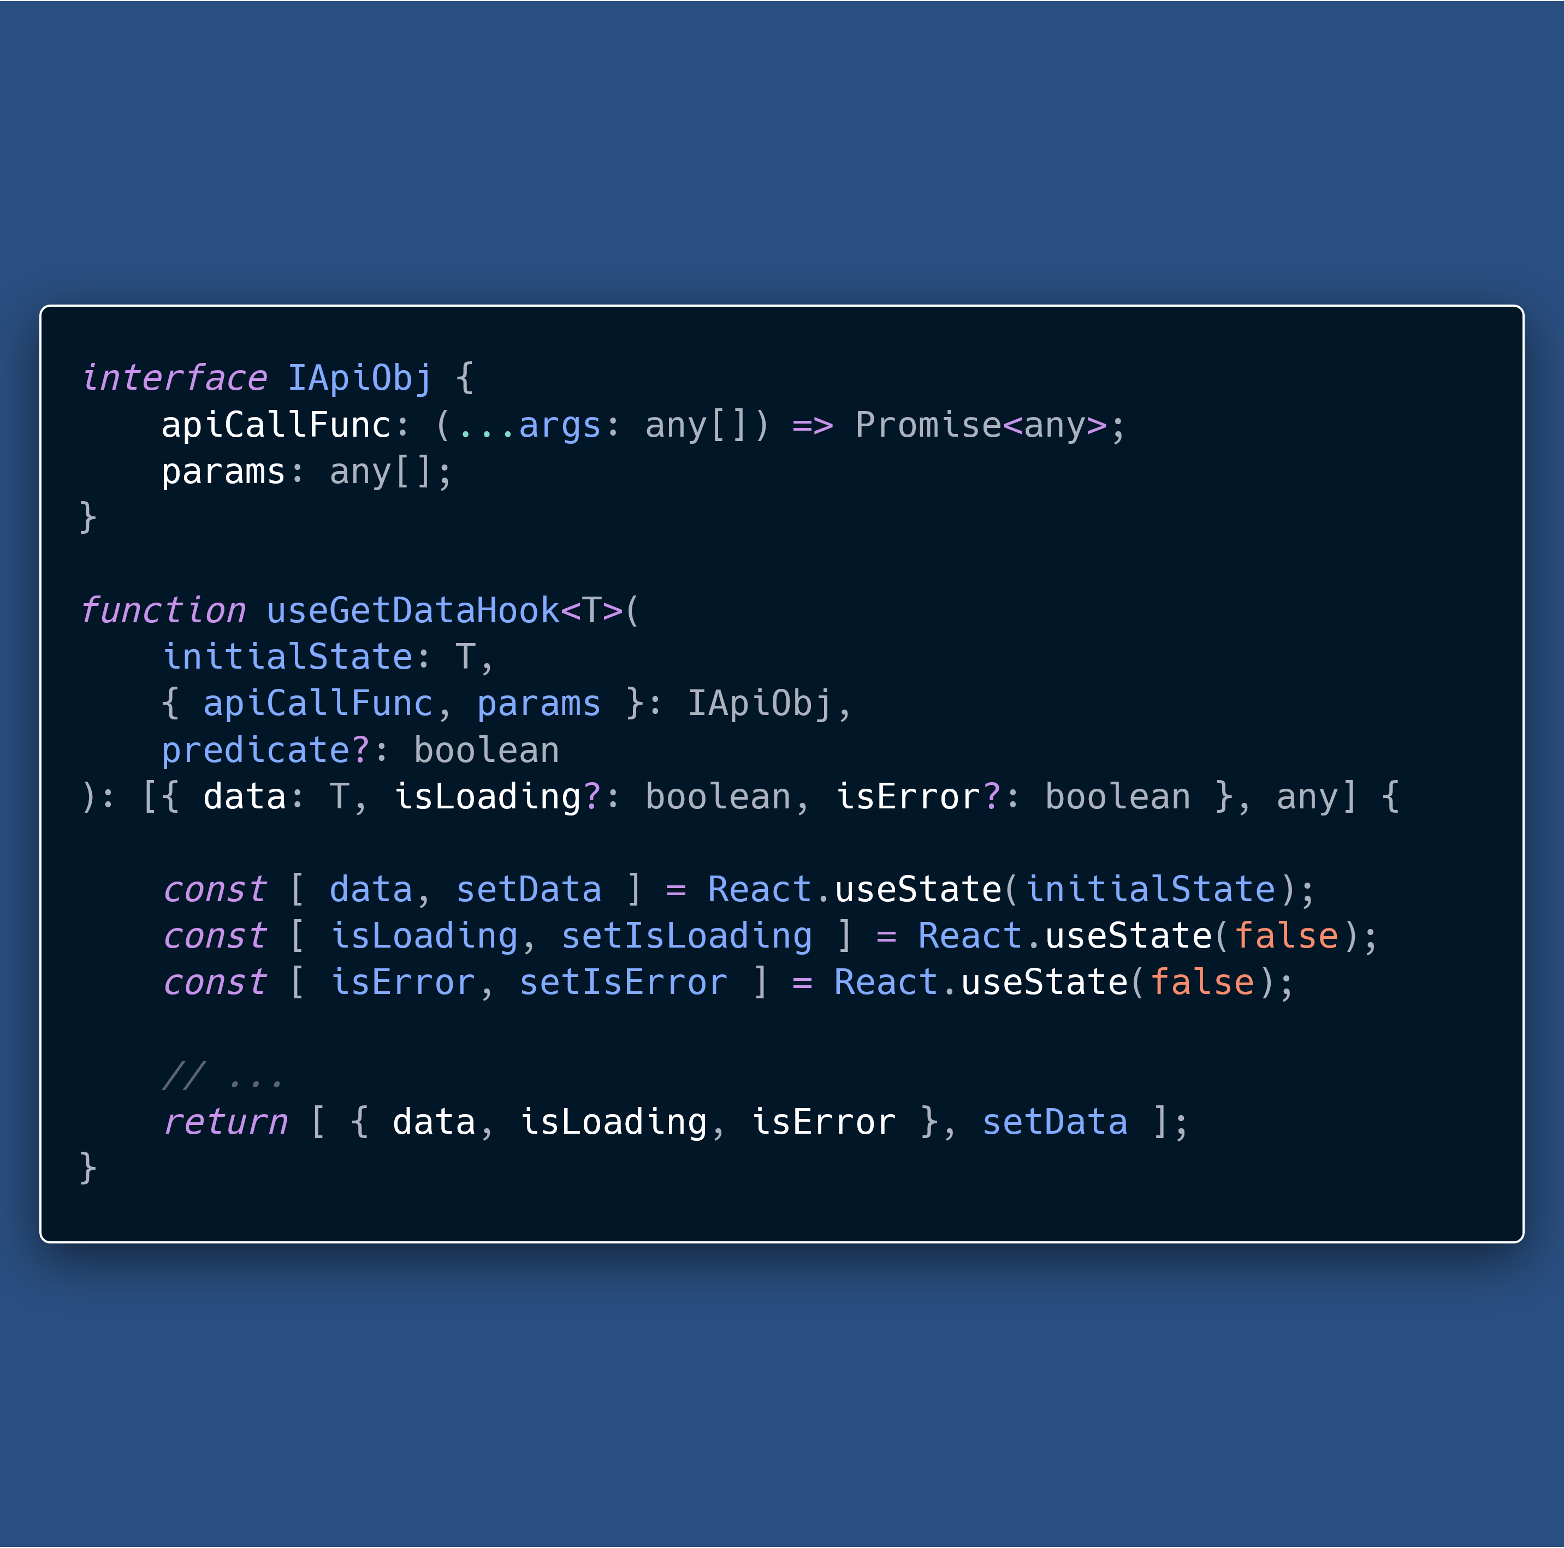

Slide 19
Run-time errors to Compile-time errors
TypeScript catches many of the errors, that would be JavaScript run-time errors, at compile time.
This works without specifying types for most of our code, because TS Compiler can infer types.

Slide 20
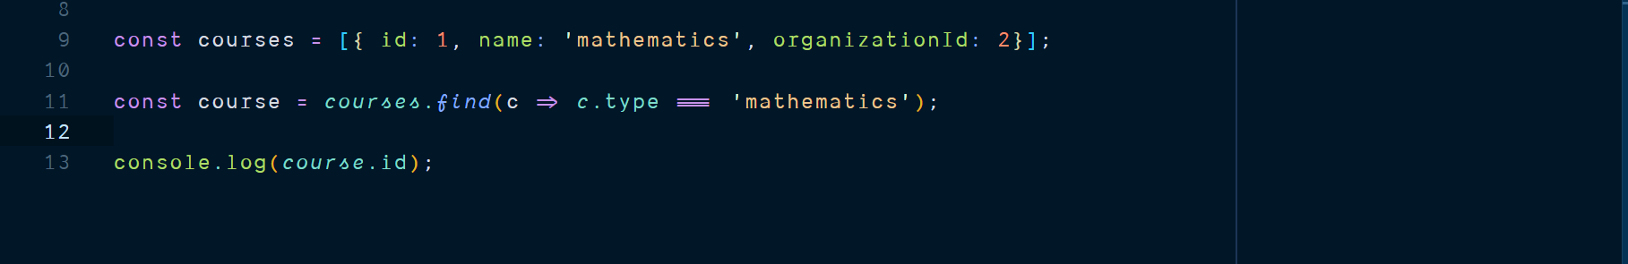

Slide 21
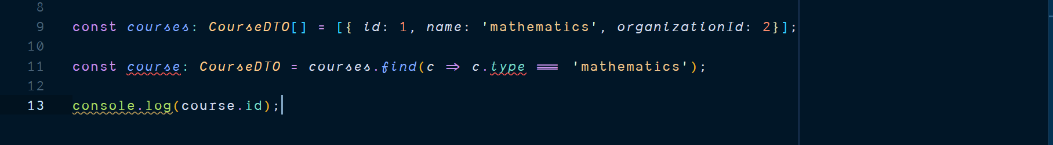

Slide 22
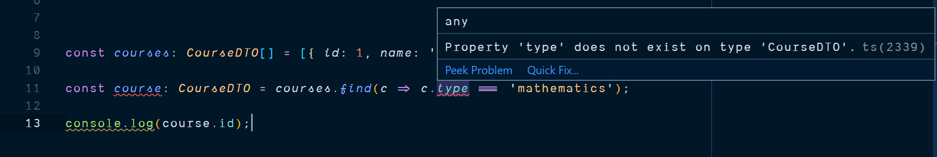

Slide 23
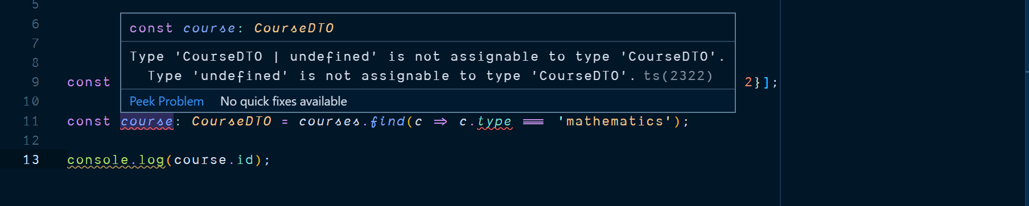

Slide 24
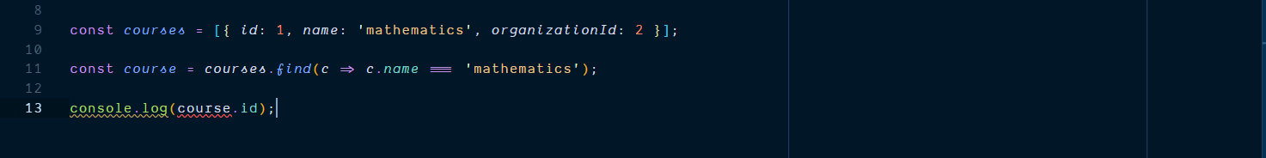

Slide 25
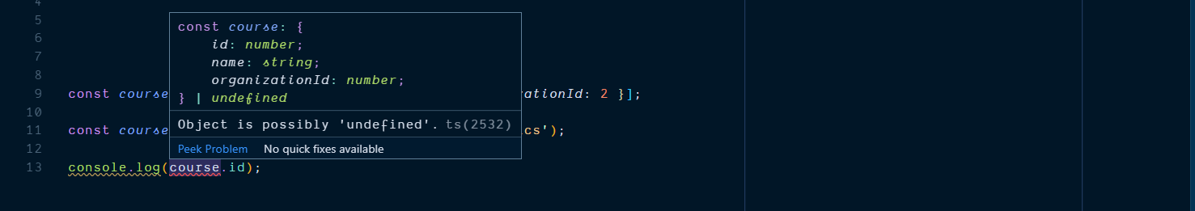

Slide 26
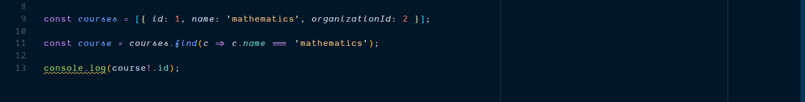

Slide 27
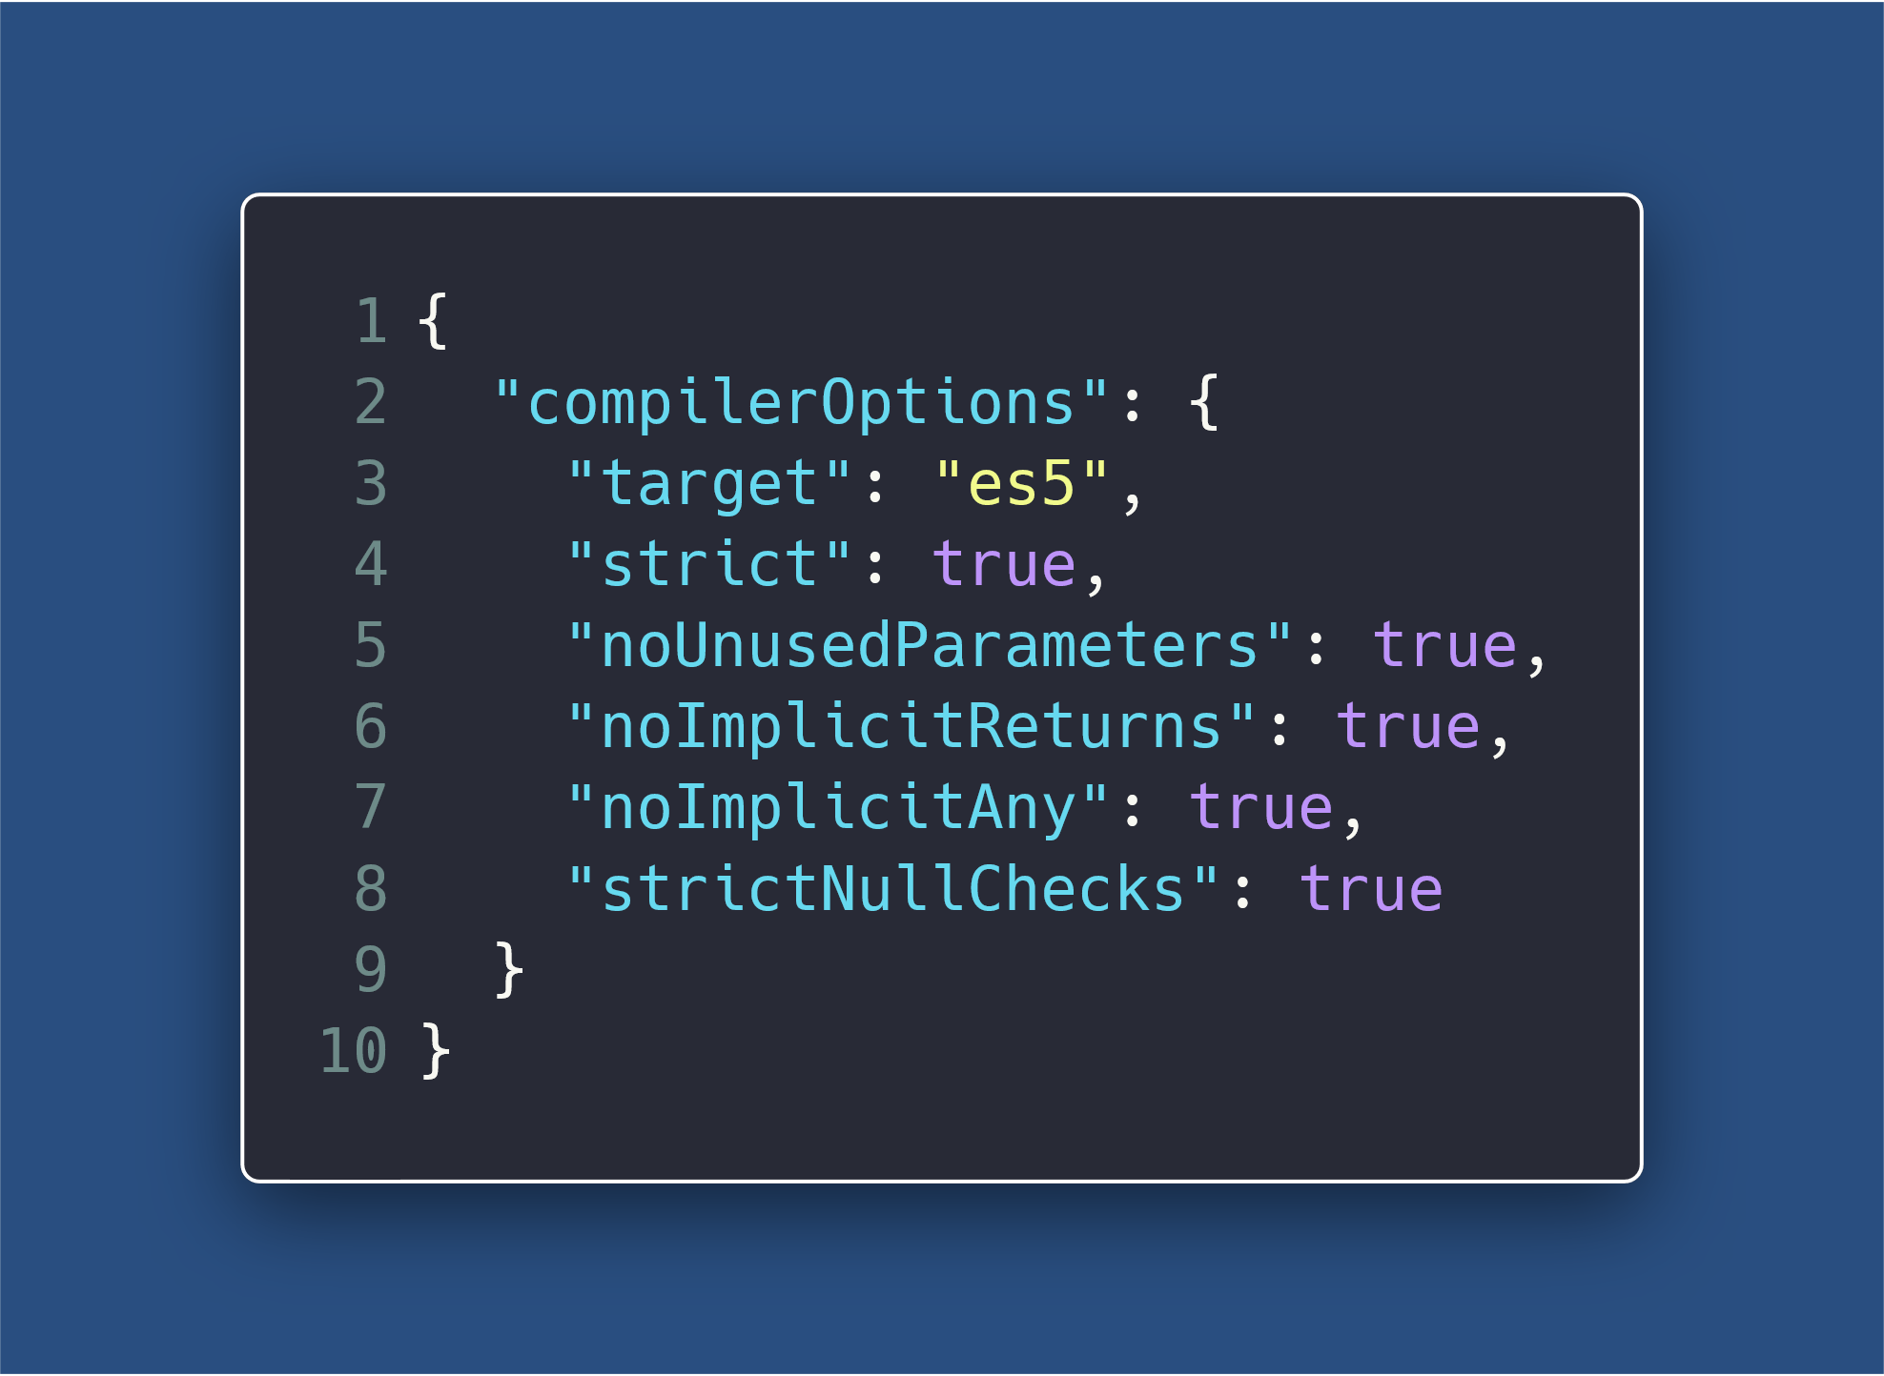

Slide 28
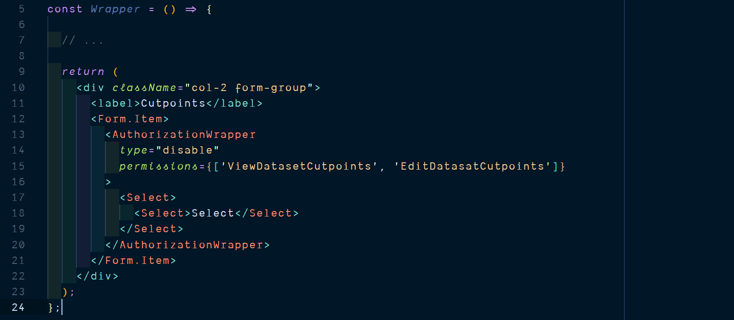
Notes:
Focus is on Authorization Wrapper
There is a type on the permissions string literals.

Slide 29
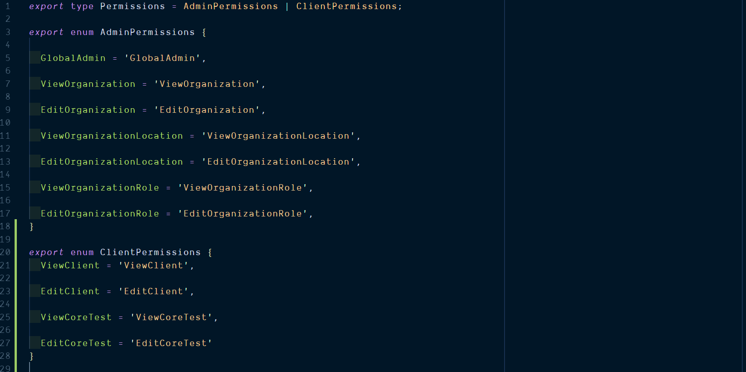

Slide 30
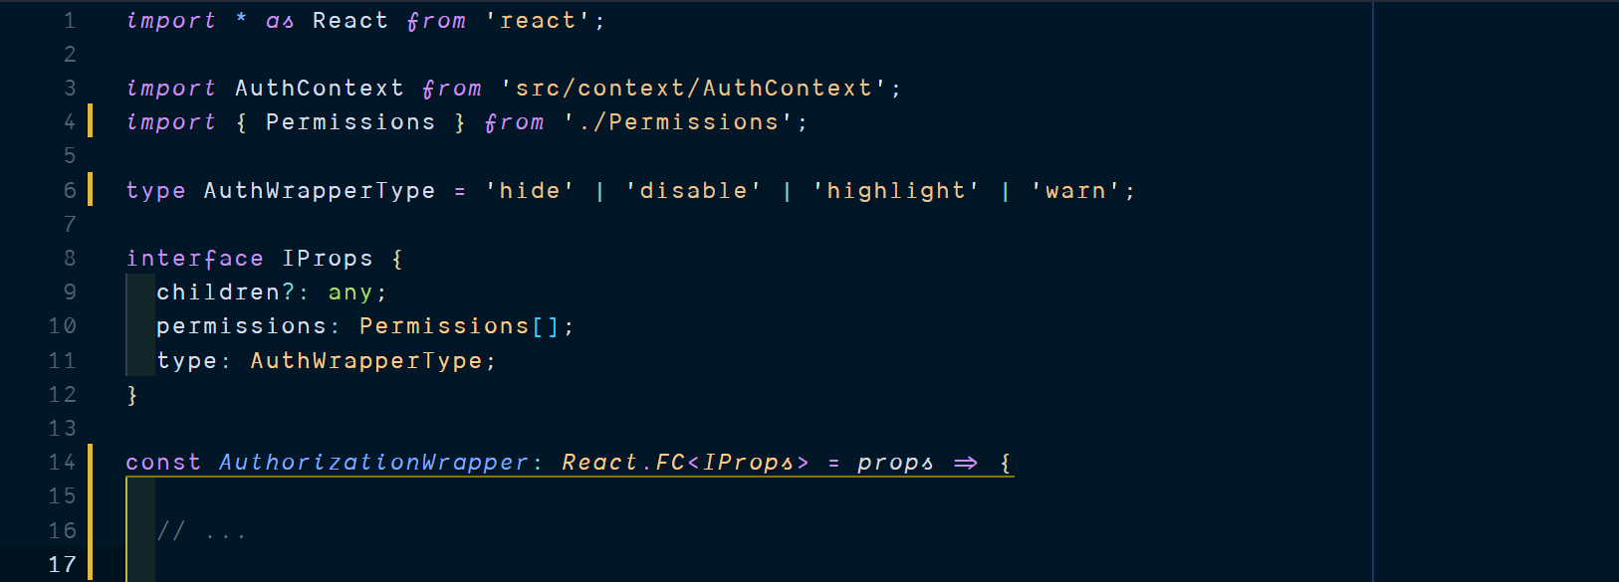

Slide 31
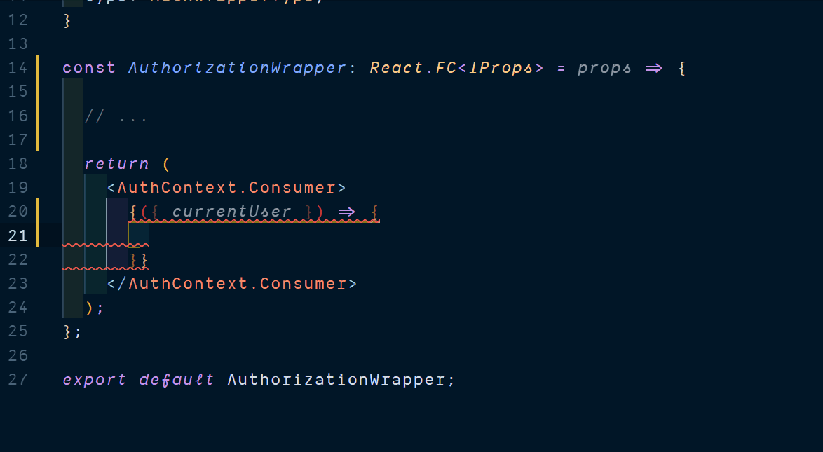

Slide 32
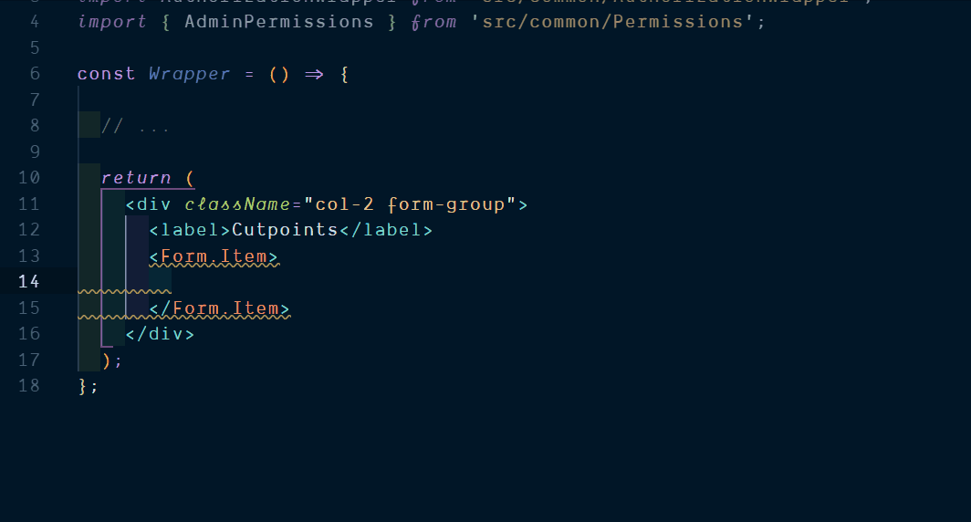

Slide 33
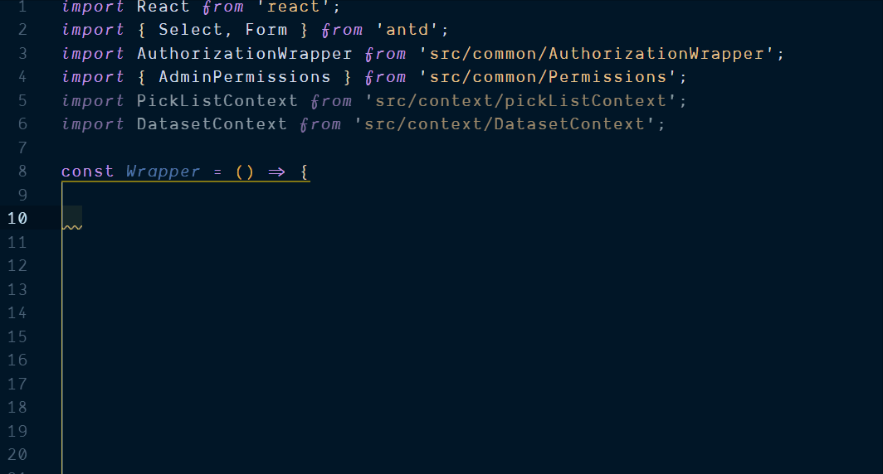

Slide 34
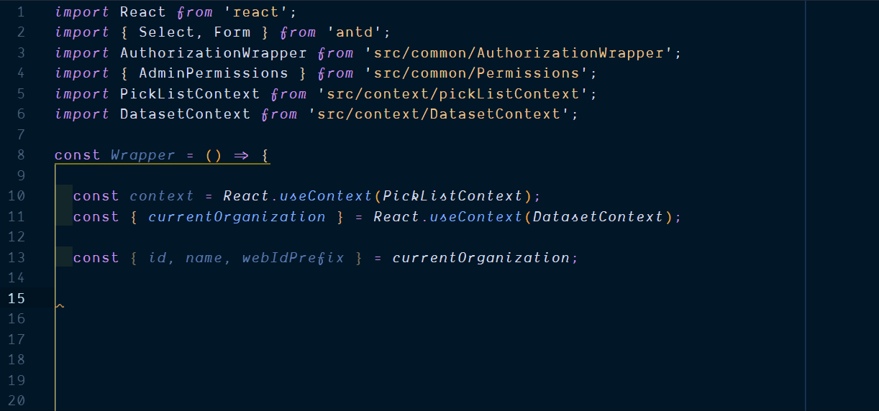

Slide 35
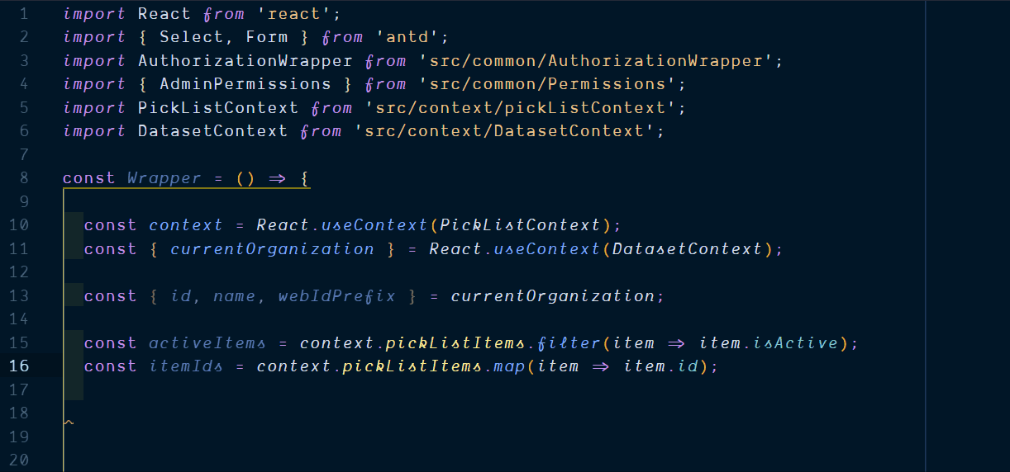

Slide 36
Oft quoted TS criticisms
Learning curve
Conflicts with existing libraries
Just another fad
It’s basically JS types with a few new concepts
Thanks to DefinitelyTyped
Nopes
Notes:
3. With the upcoming wasm, it prepares JS for the future, actually. May well be the best thing to happen to JS.
4. Type system is not sound.
5. Bebel now transpiles TS to JS

Slide 37
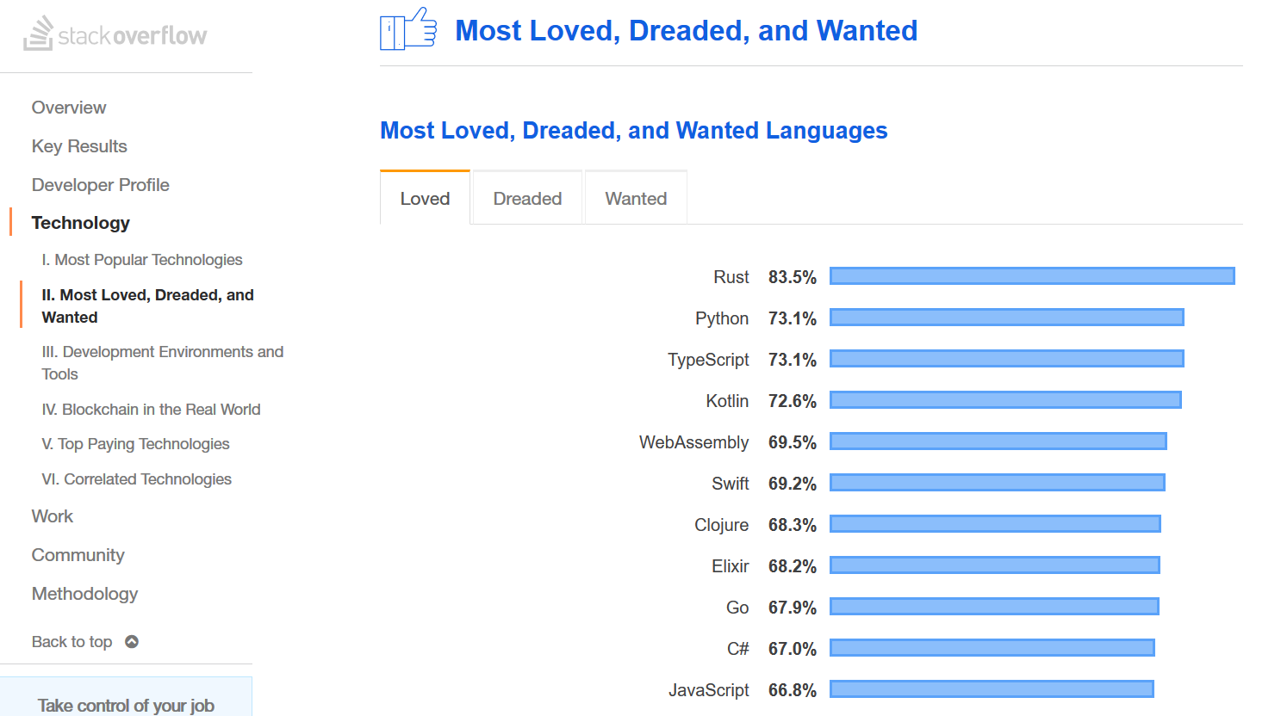

Slide 38
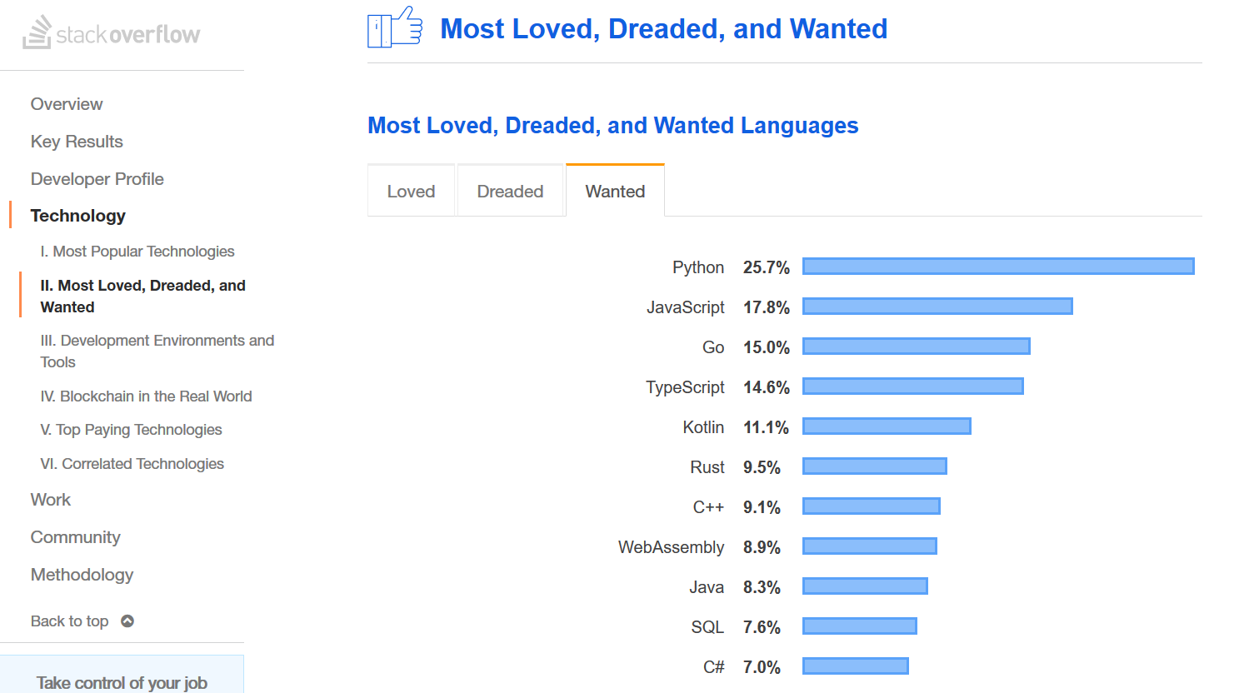

Slide 39
Oft quoted TS criticisms
Learning curve
Conflicts with existing libraries
Just another fad
Does not eliminate 100% run-time errors.
Complicated Error messages.
Difficult initial setup.
It’s basically JS types with a few new concepts
Thanks to DefinitelyTyped
Nopes
Notes:
3. With the upcoming wasm, it prepares JS for the future, actually. May well be the best thing to happen to JS.
4. Type system is not sound.
5. Bebel now transpiles TS to JS

Slide 40


Conclusion
What TS gives us:
Static code analysis
Self documenting code
Union Types & Generic Types
Easy to read and reason code
Easy to maintain and refactor code
What TS does not give us
Immutable Data Structures
Pure functions with contained side effects
Minimal shared mutable state
Zero run-time errors guarantee.

Slide 41
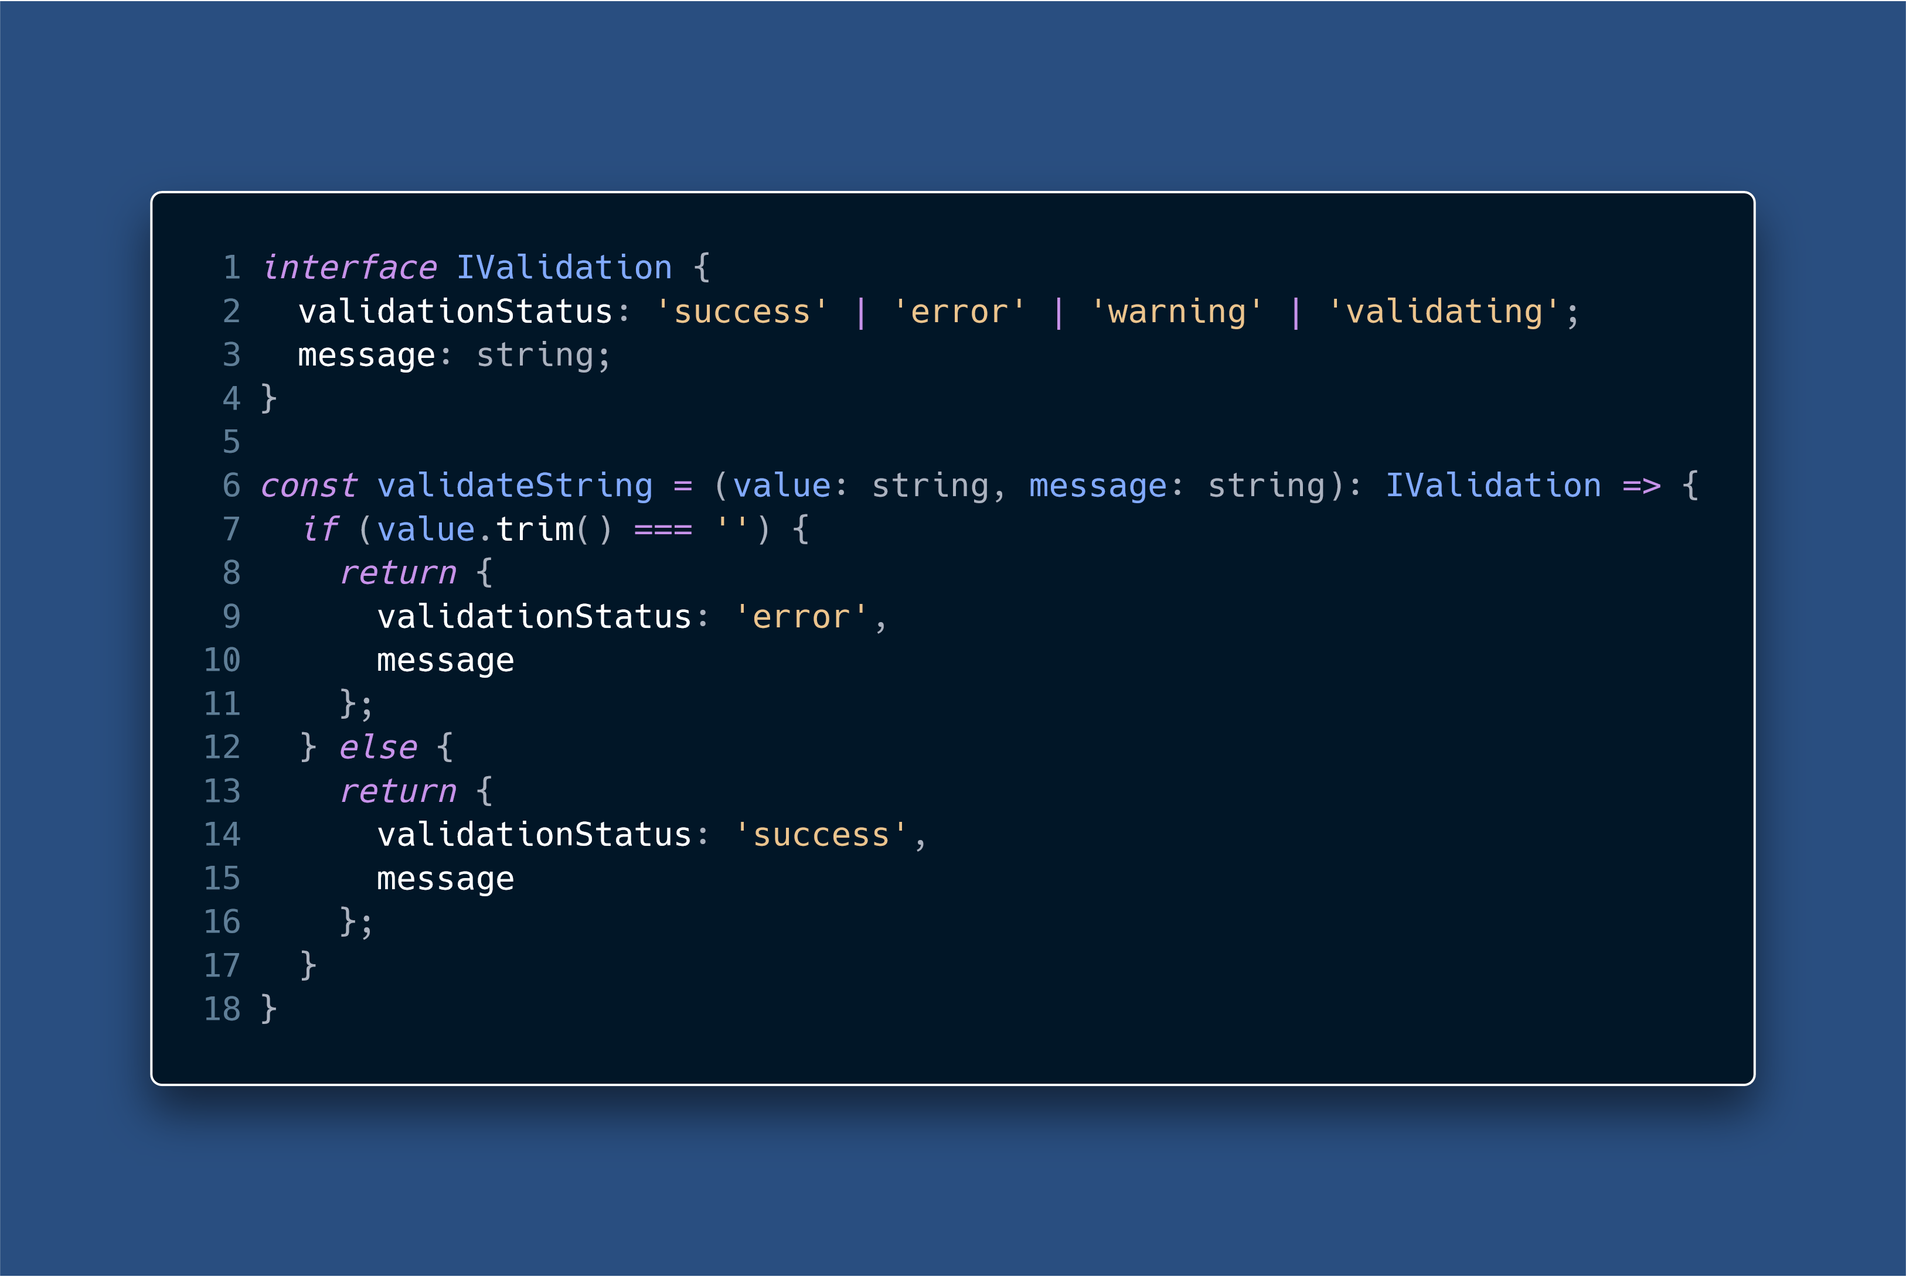

Slide 42
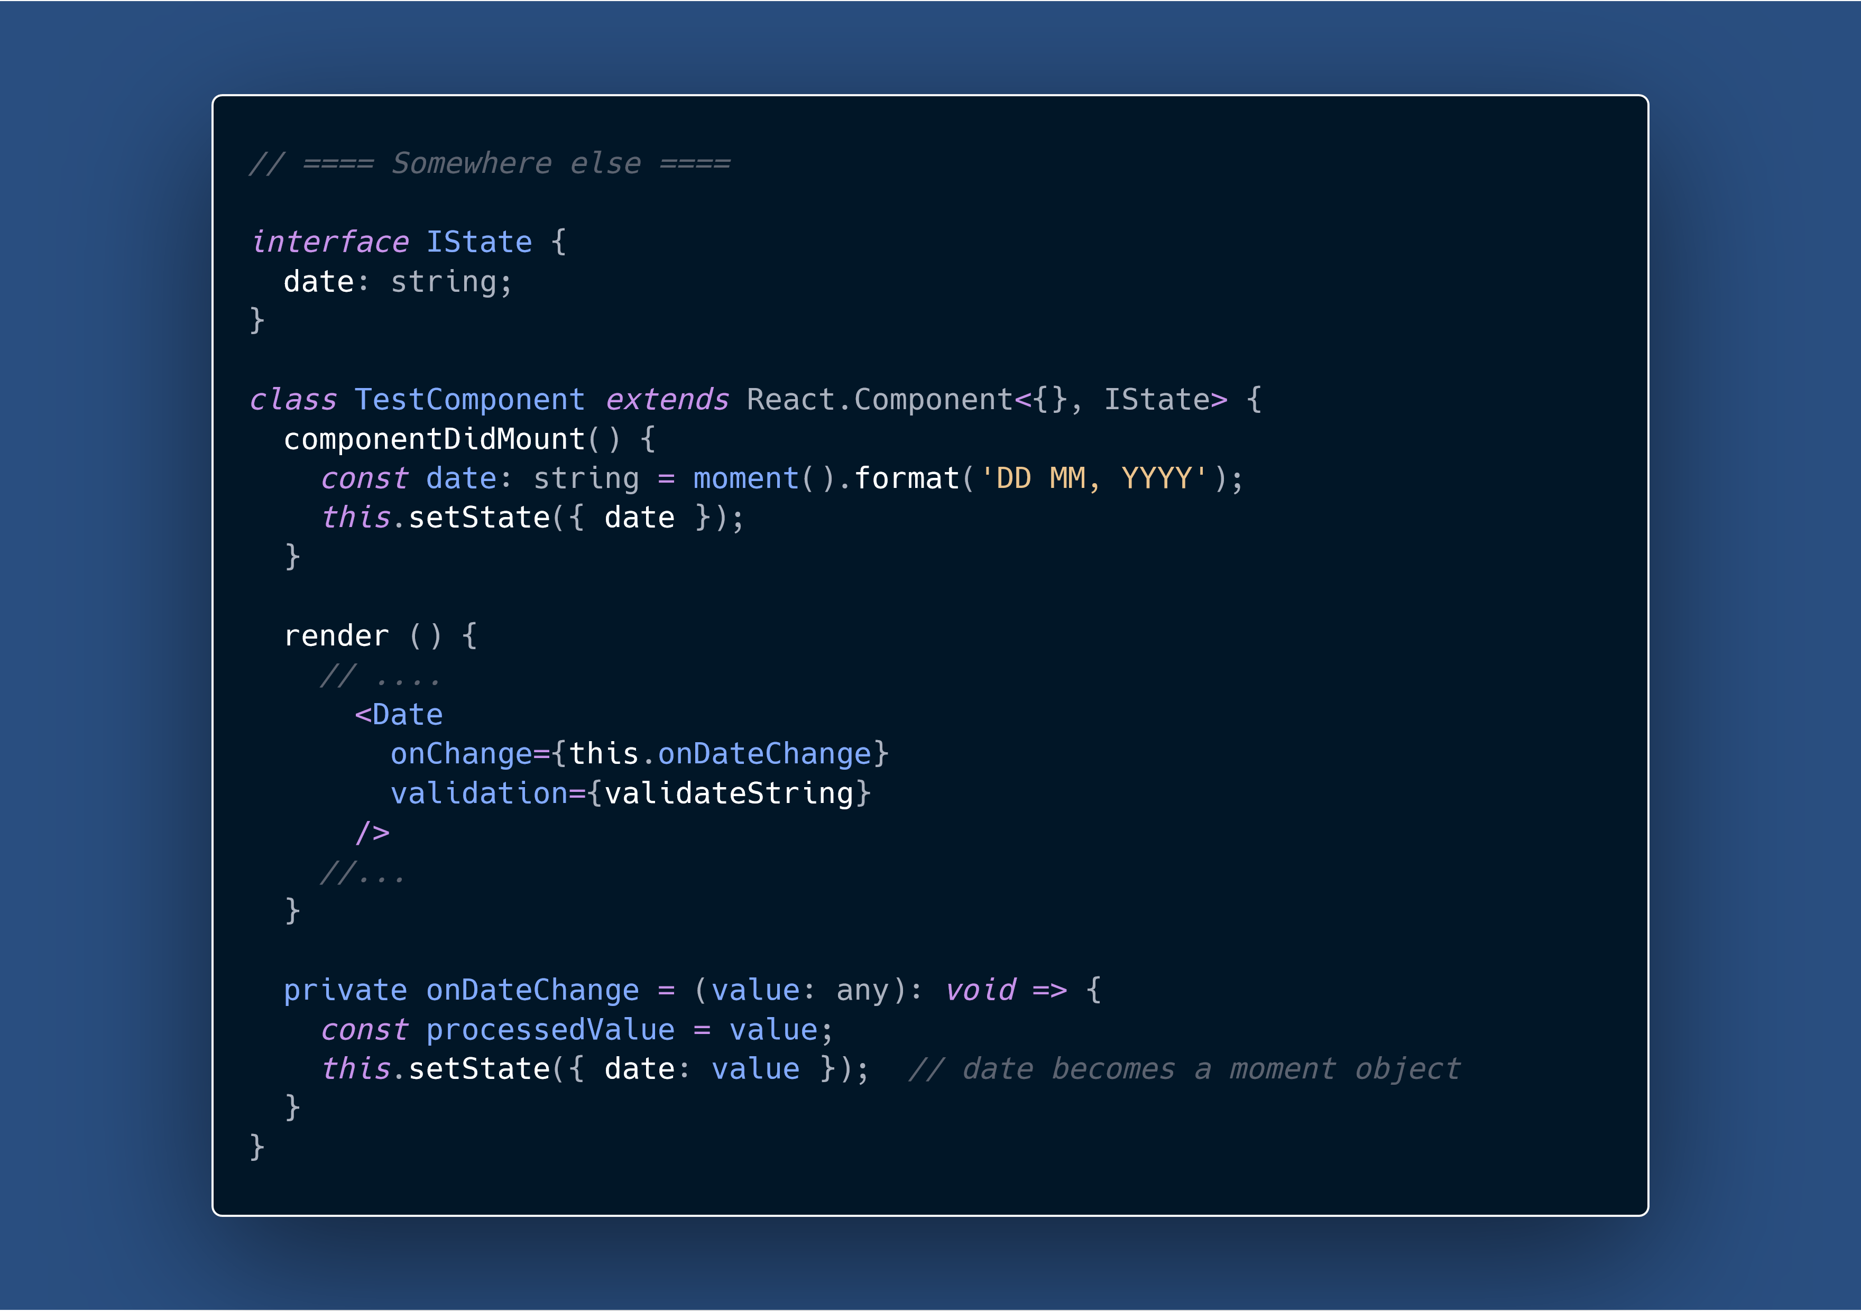

Slide 43
Questions?
Developing with React Native

